Slide 1
Guide
To
Facebook

Slide 2
Your Facebook page Makes Your Service:
Discoverable – people can search for your service online
Connected – you can have one-to-one conversations, people can read your posts, like your posts and share them with friends
Timely – your page can reach large groups of people in short space of time
Insightful – analytics on your page can give you a deeper understanding of your target audience
* Facebook uses algorithms – this means that the stories that show in your News Feed are influenced by your connections and activity on Facebook. Only posts that get a high level of engagement (likes, clicks, comments, shares) will be seen by a lot of people – regardless of whether those people are fans or friends. This opens up more real estate for Promoted Posts (ads) from companies or people.

Slide 3
How Do I Sign Up For Facebook
If you don't have a Facebook account, you can sign up for one in a few steps:
Go to www.facebook.com.
If you see the signup form, fill out your name, email address or phone number, password, birthday and gender. If you don't see the form, click Sign Up, then fill out the form.
Click Sign Up.
Once you sign up, you'll need to confirm your email address or phone number. We'll send you either an email or a text message to help you confirm your account.

Slide 4
What Is A Facebook Page?
Pages are for businesses, brands and organizations to share their stories and connect with people. You can customize Pages by publishing stories, hosting events, adding apps and more.
People who like your Page and their friends can get updates in News Feed.
You can create and manage a Page from your personal account.
Note: If you want to create a Page to represent a business, brand, organization or celebrity, you must be an official representative.

Slide 5
How Do I Create A Page?
To create a Page:
Go to facebook.com/pages/create
Click to choose a Page category
Select a more specific category from the dropdown menu and fill out the required information
Click Get Started and follow the on-screen instructions
How to Let People Know About My Page?
Invite your friends and email contacts to like your Page
Choose a custom username for your Page and include it in your marketing materials (ex: web page, emails)
Add a Like button to your webpage

Slide 6
The Language of Facebook
Page
Pages allow businesses, brands and organizations to connect with people on
Facebook
Like, comment and share
People click like to give positive feedback and connect with things they care about. Collectively this is known as engagement – brands will seek a high level of engagement on posts.
Timeline
this is where you can see your posts or posts you've been tagged in displayed by date. Your Timeline is also part of your profile
Notifications
These are updates about activity on Facebook. Notifications let you know when people take actions on Facebook related to you, so you can quickly check out a photo you've been tagged in or read a new posting on your Wall. They are available from your home page or from the notifications icon within the Facebook Chat bar at the bottom of your browser.

Slide 7
Messages
Inbox contain your ongoing conversations with people on Facebook
Block
You can block someone to unfriend them and limit the ways they can get in touch with you on Facebook. Blocking can help stop someone from bothering you on Facebook.
Follow
People can follow your page, it is a way to hear from people you’re interested in, even if you’re not friends. The Follow button is also a way to fine-tune your News Feed to get the types of updates you want to see.
Tag
When you tag someone, you create a link to their profile. For example, you can tag
a photo to show who's in the photo or post a status update and say who you're
with.
Adding a location
You can add your location to a post to tell people you're at a specific place, like a restaurant or park. To add your location to a new post: Begin writing your post
Click
Enter your location's name or select a suggested location

Slide 8
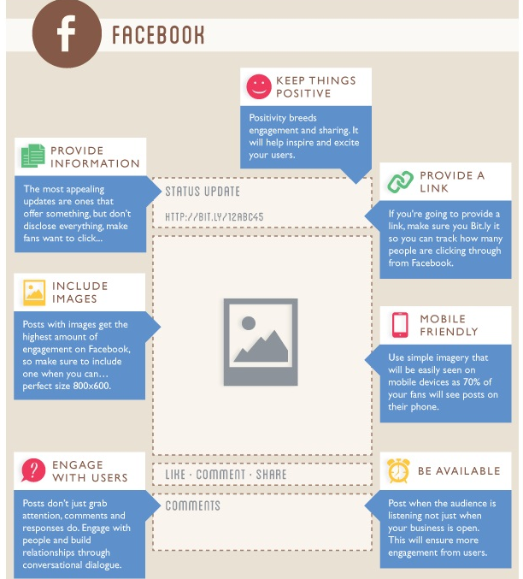
Facebook – Quick Infographic Guide

