Slide 1
Health Services Change Guide
Introduction
Insert date – would vary depending on presentation
Insert presenter name
Insert service name
Notes:
User Instruction:
On this opening slide, please include the following:
Date the presentation is given
Presenter’s name
Service name

Slide 2
Guidance for using these slides
Please note this set of slides is intended to assist you to present on People’s Needs Defining Change - Health Services Change Guide
You may wish to select from the slides included to meet your specific needs.
We do ask that all presentations include the Change Framework
Thank you for increasing awareness – as the organisational policy on change it is important that the Change Guide is included as part of all presentations on change / service improvement.
Please encourage people to go online and test out the Change Guide and associated templates / handouts – access details are profiled in this presentation.
Thank you for your support and assistance
2

Slide 3
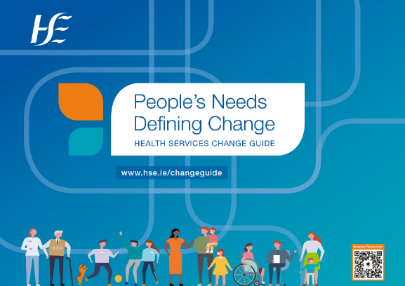
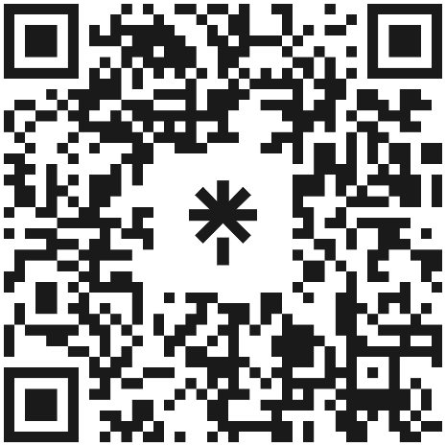
Health Services Change Guide
Support Resources
Access Resources
3

Slide 4
Purpose of this presentation
Introduce and highlight key elements of:
Health Services Change Guide & Change Framework
Outline the supports available to all staff
4

Slide 5
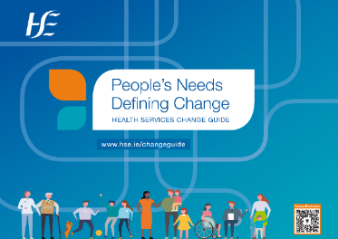
What is the Change Guide?
Agreed approach to change signed off by the HSE and Trade Unions¹.
Hands-on guide to help managers and staff across the health and social care system to make change and deal with real service issues.
Consists of:
a Health Services Change Framework
a step-by-step guide to carry out change
links to additional resources and help
5
Notes:
Speaker’s Notes:
What is the Health Services Change Guide?
The Change Guide is a helpful and practical resource to support managers and staff across the health and social care system to undertake change initiatives and consists of the following:
Health Services Change Framework
Step-by-step guidance and templates to implement the Change Framework that can be adapted and used by local teams and services
Additional Resources – signposting you to where you can get additional help (repository of resources)

Slide 6
Purpose of the Change Guide
Simplifies change in a complex system
Gathers in one place guidance needed to undertake change and improve services.
Guides you through the change process with supporting templates and resources that can be applied and adapted.
Sign posts you to where you can get more help - resources in the system.
6
Notes:
Speaker’s Notes:

Slide 7
Purpose of the Change Guide
Helps people to do change well
Assists individuals and teams build change capacity to undertake change initiatives with confidence.
Recognises the importance of working with people in their local context to deliver change that meets local needs.
7

Slide 8
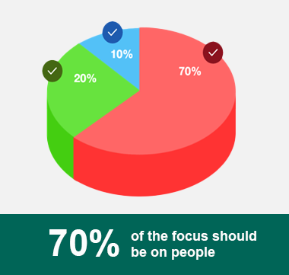
People at the heart of change
.
Evidence is clear – we underestimate the human factors in change
Need to focus on people & culture change (70%) and not just on processes (20%) & systems (10%)
Change levered from the ‘outside in’ is more powerful
All 3 areas (people, process and systems)
are important and interconnected
8

Slide 9
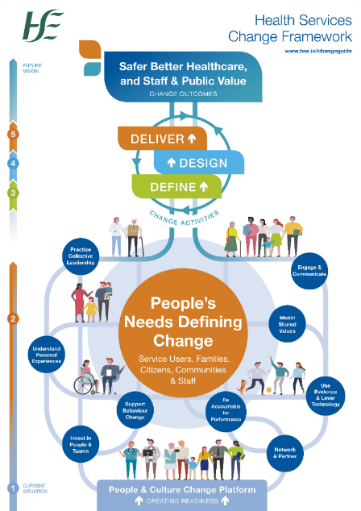
What is the Change Framework?
An overarching framework that enables a whole system approach to delivering change.
Focused on people and culture change.
Context specific - a ‘tailored’ organisational offering, informed by evidence and research, and applied to an Irish health and social care context.
Connects and complements other approaches to service/quality/culture improvement in the system.
9
Notes:
Speaker’s Notes:
Why is a Health Services Change Framework Needed?
People’s Needs Defining Change – Health Services Change Guide presents the overarching Change Framework that connects and enables a whole system approach to delivering change across the system. The Change Framework is a tailored organisational offering that has adapted lessons from research and experience on change to an Irish health and social care context – in this way it offers the best chance of success, is evidence informed, practice based and context specific.
The Change Framework provides a coherent conceptual foundation and support for the major change programmes which the health services are already undertaking or are about to embark upon. The approaches to managing change which have informed the Change Framework include:
the changing nature of change itself
new models of power relationships that prioritise engagement and empowerment
the need to create a receptive environment for change that understands local needs and context
new understandings of complexity in health and social care systems
Agreed approach to change
It is the agreed approach to change which is signed off by HSE Leadership and the Joint Information and Consultation Forum representing the Trade Unions.

Slide 10
10
Notes:
Speaker’s Notes:
Change Framework
The Slide presents the Change Framework – it locates in one place all of the important elements that need to be focused on to deliver change well. These include:
People’s Needs Defining Change: working with people through a discovery process to understand their needs and support ongoing engagement.
Create People and Culture Change Platform: the change priorities that need to be worked on together to create a healthy environment and the conditions for change.
Define, Design, Deliver: the change activities
Define: Initiate change, define the purpose, assess the context and scale and get prepared
Design: Determine the detail, plan and test, identify resources and agree Action Plan
Deliver: Implement change, measure outcomes and support sustainability
Change Outcomes: Being accountable for performance and the delivery of safer better healthcare, and services that are valued by the public and by staff.
The Change Framework starts with the People and Culture Change Platform (1) (bottom-up approach) to create readiness for change before moving to consideration of people’s needs to define the change (2) and then to the Change Activities of (3) Define, (4) Design and (5) Deliver.
The numbering on the side of the infographic 1-5 signposts the journey through the framework from the Current Situation to the Future Vision which aims to deliver Safer, Better Healthcare and Staff Pride and Public Value (Change Outcome).

Slide 11
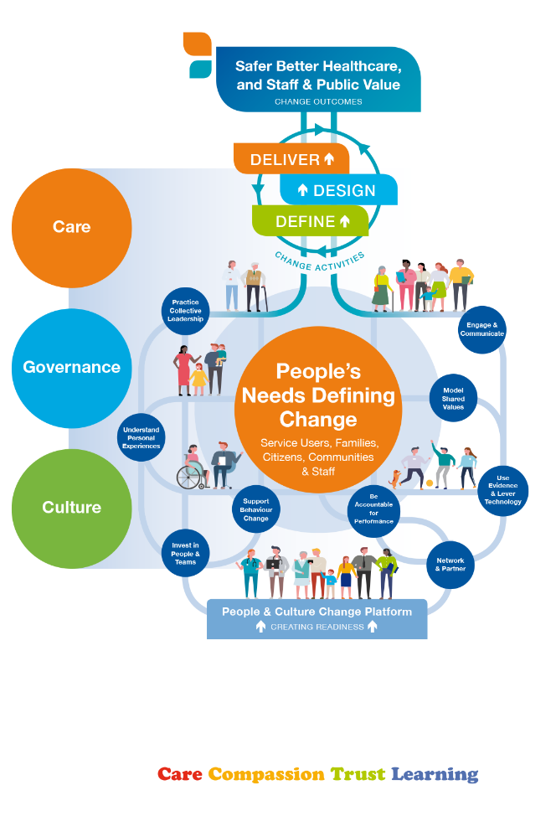
Health Services Change Framework
Change Framework - brings together all the elements you need to focus on to deliver change.
Places People’s Needs Defining Change at the centre of all change initiatives.
Recognises that change is essentially about people.
Prioritises engagement - ‘people support the change they help to create’
11
Notes:
Speaker’s Notes:

Slide 12
Health Services Change Framework
Focuses on a People and Culture Change Platform to prepare an environment where change can be encouraged and developed.
Provides guidance on change activities:
Define what needs to change and clarify why.
Design a better future with all key people involved.
Deliver and sustain the change.
Supports you to deliver change outcomes - safer better healthcare & services that are valued by the public and by staff.
12
Notes:
Speaker’s Notes:

Slide 13
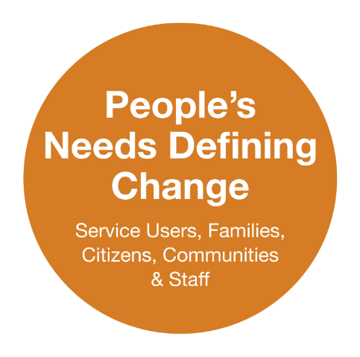
Health Services Change Framework
13
Notes:
Speaker’s Notes:
People’s Needs Defining Change:
The Irish health and social care system is prioritising person-centred care ­– more choice, more personalised care, and real empowerment of people to improve their health and wellbeing. This ‘shift in power’ moves us from a service that does things to and for its service users to one which is service user-led, where the service works with people to support them with their health and social care needs.
The Change Framework guides you on how best to work with service users, families and staff to understand their needs, value their lived experiences and insights, share their personal stories and work with people to design service improvements.
Provides detailed guidance on engagement with a particular focus on practicing co-production, identifying and mapping people connections.
Supports you to tailor engagement to key groups and plan and engage with a purpose.
Provides guidance and templates to develop and sustain communication and engagement plans.
It recognises the real value of change that is shaped from the ‘outside in’ – influenced by local communities, service users, families etc.
Focus on Human Centred Design
The Change Framework recognises the value of change being shaped by people’s needs and prioritises an approach that reflects this orientation. It is also founded on a human centred design philosophy and the principles of co-production (as noted above) – it recognises that people who receive and deliver services are best positioned to provide relevant insights into service design.

Slide 14
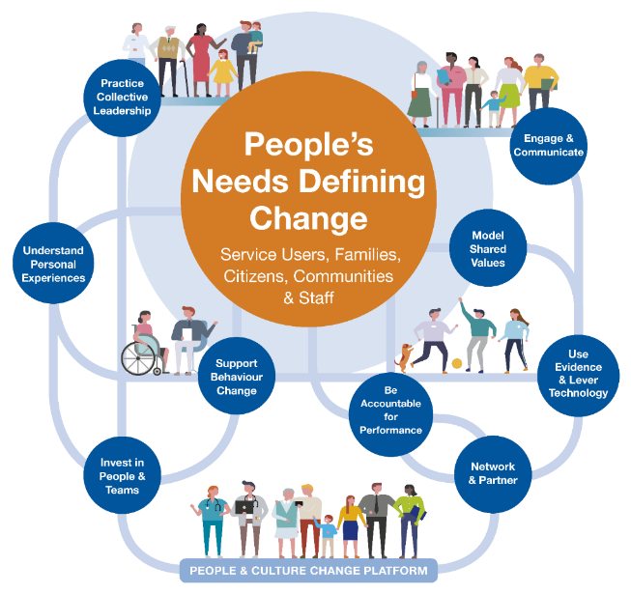
Health Services Change Framework
People & Culture Change Platform
14
Notes:
Speaker’s Notes
Core to the framework is the People and Culture Change Platform: the platform represents the change priorities that need to be worked on together to create a healthy culture and environment for change.
All of the elements are important and require consistent and focused attention throughout the change process.
Mobilising the people and culture change platform (as a collective) creates and sustains the momentum and energy for change.
Attend to the People and Cultural Change Platform on an ongoing basis with your team and change activity will become more fluent and part of how the team approaches its service delivery challenges.
All of these priorities are currently getting individual attention across the system - however it is focusing on them in a connected way that will deliver the ‘added value’ and increase readiness and capacity for change.
“Engage and communicate” in particular needs/attention throughout the change process.

Slide 15
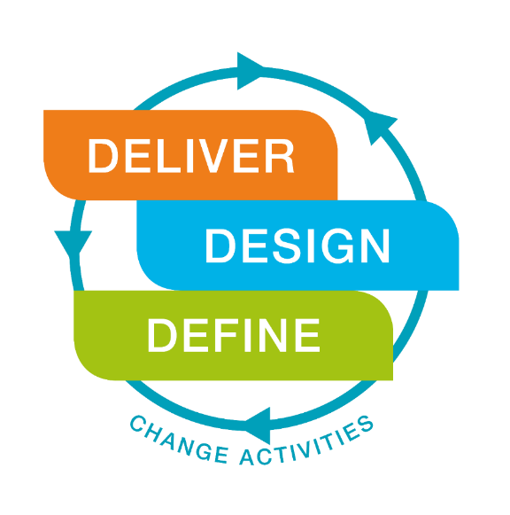
Change Activities
15
Notes:
Speaker’s Notes:
Define, Design, Deliver: the change activities
We have identified the change activities as define, design deliver – the stages are inter connected and ‘iterative’ – change is not linear and goes through multiple cycles of engagement.

Slide 16
Change Activities
Identify shared purpose
Understand current services
Agree better outcomes
Measure for success
Make case for change
Agree to co-design
Design service operational model
Test and refine
Agree Action Plan
Communicate Action Plan
Implement actions
Support implementation
Measure progress
Celebrate success
Sustain improvement
16
Notes:
Speaker’s Notes:
The Change Guide provides detailed assistance to people to:
Define: Initiate change, define the purpose, assess the context and scale and get prepared
Design: Determine the detail, plan and test, identify resources and agree an Action Plan
Deliver: Implement change, measure outcomes and support sustainability and spread where appropriate
The Change Guide provides very detailed guidance in relation to each of these activities – it also provides templates and session plans.

Slide 17
Change Outcomes
17
Notes:
Speaker’s Notes:
The Change Frameworks is outcome based.
Our public service accountability to deliver safer better healthcare in a context of increased demands and finite resources requires healthcare staff to find innovative ways to develop services collaboratively with citizens, service users and staff and to create public value.
Public value: The Change Framework positions staff and public values as key change outcomes – this requires a shared understanding of the important values that citizens, taxpayers, services users and communities want to see achieved by public service organisations. It also presents a way of improving decision-making by calling for public service leaders to engage with service users and the wider public, thereby promoting greater trust in public institutions.
Many teams have inserted their own outcome at the top of the Change Framework diagram. Being clear on the outcome you want to achieve as part of a change process is a key starting point (See page 62 of the Change Guide – Agree Better Outcomes.)
Change Outcomes: Being accountable for performance and the delivery of safer better healthcare, and services that are valued by the public and by staff.

Slide 18
Human Centred Design
18
Notes:
Speaker’s Notes:
Change Guide focuses on Human Centred Design – to deliver person centred care
The Change Framework recognises the value of change being shaped by people’s needs and prioritises an approach that reflects this orientation. It is also founded on a human centred design philosophy and the principles of co-production – it recognises that people who receive and deliver services are best positioned to provide relevant insights into service design.
Human centred design is an enabling and collaborative methodology involving active citizenship and community empowerment. It starts with people’s needs, redistributes power and puts people at the centre of decision-making. It signals a shift from designing from the inside out to designing from the outside in – bringing the needs of citizens in balance with the requirements of the organisation. It enables service user and citizen experiences to drive organisational change working in partnership with staff.
See Slide: Human-centred design begins with a discovery process that involves various types of activities in which we learn from our service users about what their experiences are. Developing this level of insight requires us to empathise with service users so that we have a deep understanding of their needs. This enables us to define the problem we need to solve or address. Through a design process we can then consider options and put in place ways to test and refine possibilities. This process of testing enables us to come up with a preferred option for delivery. Part of the process of human-centred design also requires us to consider how feasible our options are from a public value perspective – whether they are technically and organisationally feasible and financially viable (Figure 49a, page 73 in the Change Guide).
Engagement is a key element of delivering on human-centred design and person centred care.

Slide 19
Why would teams use the Change Guide?
1. Increases your chance of success by:
providing all the help you need to carry out change and improve services.
guiding you on how best to work with service users, families and staff to understand their needs, value their experiences and design service improvements.
2. Simplifies change in a complex system by:
recognising the importance of working with people in their own situation to design and deliver change that meets their specific needs and local context.
providing an opportunity to connect change and service improvement initiatives at local and national level.
19

Slide 20
Why would teams use the Change Guide?
Helps people to do change well by:
Helping teams to develop the ability to carry out change initiatives with confidence.
Guiding you through the change process in detail, with lots of helpful resources.
See details in the following slides on resources and supports available.
20

Slide 21
21
Notes:
Speaker’s Notes:
The Change Guide in Action is a virtual workshop. It allows participants review a co-design people and culture change shared experience, focuses on an examination of the Change Guide in action and the application of the core concepts, tools and templates to a specific change challenge. It also signposts other resources from the Change Guide.
Change Consultation Clinics are one-to-one scheduled Change Consultation Clinics for those who are immersed in change and who would like support on a once-off basis. The Change Consultation Clinics are facilitated by experienced HSE Organisation Development (OD) Practitioners who take a systems approach using the Health Services Change Guide / Framework.
Staff can also avail of coaching and mentoring pertaining to initiating and managing change by contact change.guide@hse.ie
The Change and Innovation Practice Programmes are co-designed as bespoke offerings to services – these are commissioned and sponsored by senior management teams and co-designed with services.

Slide 22
22
Notes:
Speaker’s Notes:
The eLearning Programme is available on HSeLanD. It is made up of 4 modules explaining the framework in detail and sharing case studies of how it is used in practice.
CPD points: Once you have completed the eLearning Programme you are encouraged to identify a change challenge within your service and apply the learning, knowledge, skills and tools to your service improvement in collaboration with your service manager and team colleagues. The application of learning to your change challenge can take place over nine months from completion of the eLearning Programme. 12 CPD/CEU points are awarded in collaboration between RCSI/HSE and endorsed by NMBI and CORU.
Reflect Renew and Recover - this resource is available to all teams to take time to reflect, renew and recover at times of significant change. Staff are encouraged to reflect with sensitivity, recover with kindness and renew with hope.
It includes facilitator / team leader instructions along with PowerPoint Slides and a series of one-page leaflets based on the Change Guide – supporting reform in line with the current context of rapid emergent change.

Slide 23
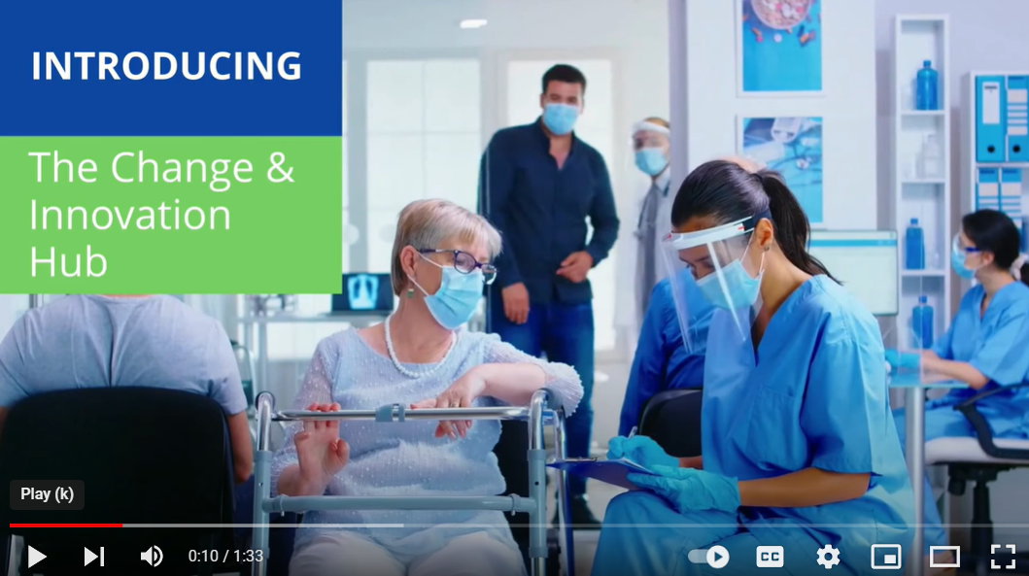
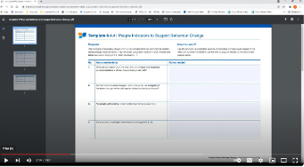
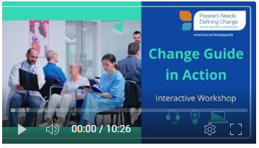
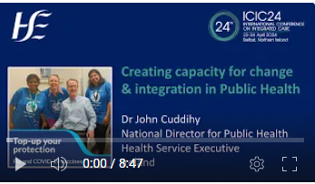
Change Guide Resources
Access our YouTube Videos
Change Guide Resources
Explanatory videos
Change & Innovation Hub
Prompts to assist you navigate
Essential Templates
Guidance on how to use
Creating Conditions for Change
Listen to case studies
Change Guide in Action
Stories of change
CPD Certificate
How to get CPD points
Delivering Change Together
Change programme insights
Interviews with Change Leaders
Sharing experiences
https://studio.youtube.com/channel ODD
HSE Organisational Change Unit
September 2024
23

Slide 24
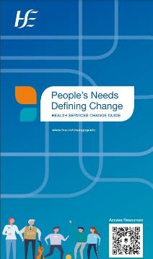
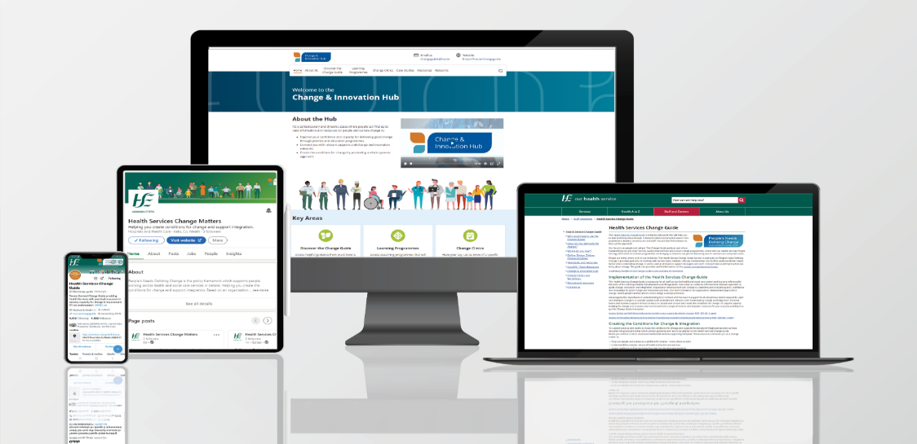
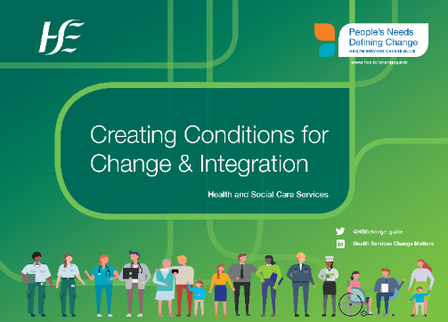
Resources to deliver
Change & Improvement
Online and in your hands
24

Slide 25
Appendix: Change Guide Development Process
Extensive engagement, consultation, development work, testing and refinement.
Practice based - informed by people’s experiences of implementing change.
Evidence informed including robust analysis.
Literature Review commissioned from Trinity College Dublin and an extensive review of grey literature.
Testing and refining based on user experience of the guidance document.
25
Notes:
Speaker’s Notes:
Development Process
The development for the Health Services Change Guide and Framework took place over two years (2016–2018). The collaborative process of design was informed by the applied experiences, learning and practice of many individuals, groups and organisations. Governance arrangements were put in place to provide oversight including guidance by the Joint Information and Consultation Forum, the Programme for Health Service Improvement, Centre Transformation Programme and the HSE HR Leadership Team.
Stakeholder Engagement
A comprehensive stakeholder engagement process was designed and implemented. This included the establishment of Reference Groups to provide assistance in relation to the early development phase, to inform the detailed design phase, to support testing and refinement of the Change Framework, Guide and associated Templates. Engagement processes also included a significant number of individual and group consultation sessions and workshops with content ‘experts’ in relation to key elements of the Change Framework. Survey methods were also used to obtain feedback on the Change Framework. Members of the HSE National Staff Engagement Forum based on their own personal experiences of change contributed to the process through submissions and feedback and informed associated communication and implementation. Engagement with service users informed the process – this was achieved through ongoing organisation development practice based sessions and other feedback methodologies conducted during 2016/2017.

Slide 26
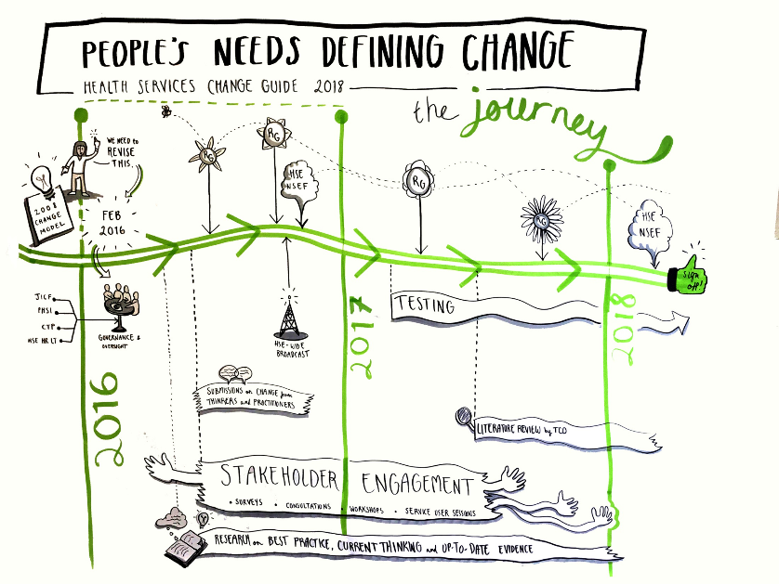
26
Notes:
Speaker’s Notes:
Development Process Continued…
Research and Evidence
A formal literature review (see reference above) was commissioned from the Centre for Health Policy and Management, Trinity College Dublin and an extensive review of the grey literature was also carried out by the authors to inform the development. This level of review has ensured the Change Framework is informed by best current thinking on change and up to date evidence. Submissions were sought from a wide number of people and organisations throughout the system reflecting change leaders, practitioners, academic contributors across a range of behavioural and human science fields. Submissions were also sought from all parts of the HSE – this included targeted consultation with teams across the system. An organisation wide broadcast issued to all HSE staff was conducted in October 2016 yielding very insightful submissions from staff and teams at all levels.
Testing, Refinement and Document Drafting
The development process prioritised testing the Change Framework in order to ensure the guidance and Templates were accessible, user friendly and could be applied within different local contexts. This included data gathering, analysis and significant redrafting of documentation. The Health Services Change Guide was shared at different stages in its development and based on extensive feedback was refined to support the final ‘sign off’. Different methodologies have also been explored to ‘bring the change framework to life’ through visual representation.

Slide 27
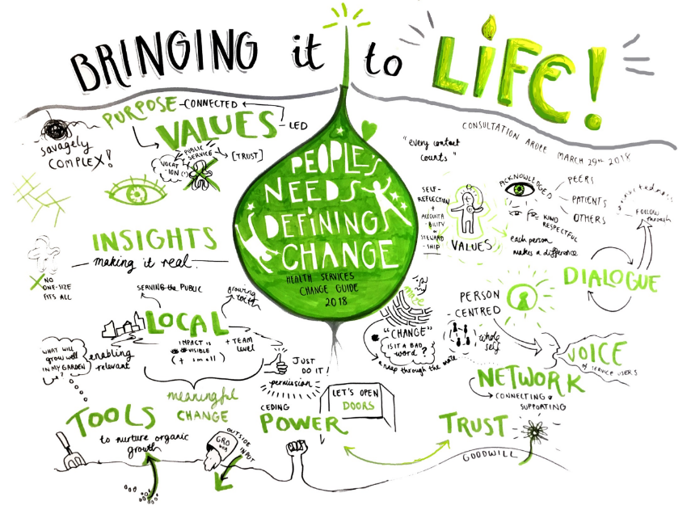
27
Notes:
Speaker’s Notes:
Outcome from one of the co-development sessions – graphic highlights some of the key messages from staff who were involved in the development process.
Title of the Change Guide emerged from this session: putting people’s needs at the centre of change, delivering person-centred care.
Recognising the importance of local context.
Tuning into people’s insights on change, listing to diverse voices.
Importance of dialogue to build trust.
Changing power relationships – value of networks and connections across the system.
Re-connecting with our core purpose and values – recognising our pubic service ethos.

