Slide 1
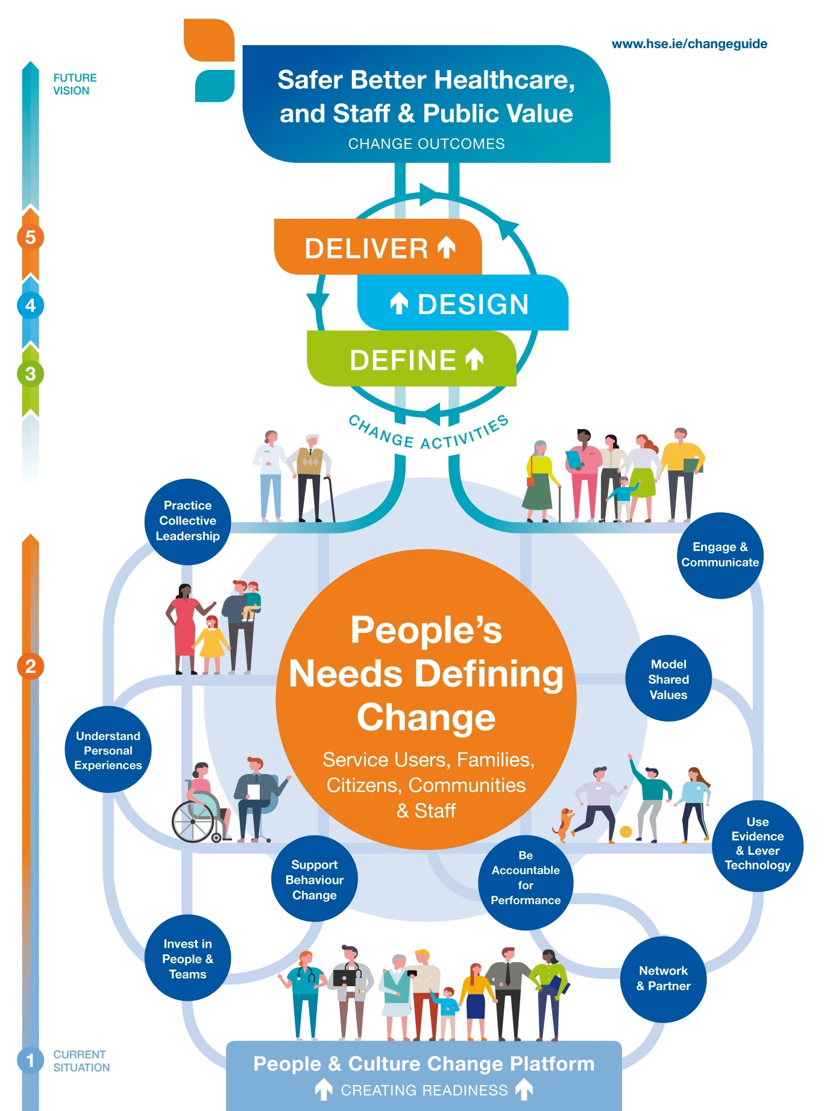
SAMPLE POSTER
PRESENTATION TEMPLATE
Welcome to the Change Guide Poster Presentation template.
Conditions of use:
This poster is intended for use by HSE staff and HSE funded agencies section 38 and 39.
It can be used to present your service improvement or initiative at internal or external conferences.
Please keep the Change Guide logo in place and insert your organisation or service logo as appropriate.
Headings and space for text have been incorporated into the poster, please use this layout and supporting images. You may wish to add your own images/graphs/tables as appropriate.
Text/font size can be adjusted to meet your requirements.
Posters can be printed to the standard conference size of AO and in portrait and printed in colour on a single sheet for easy mounting to the poster boards. Poster presentations should include:
Introduction,
Engagement
Aims and objectives
Methodology, evidence and planning
Discussion and conclusion
Outcomes
Acknowledgements and References
Please ensure that you include funding bodies and relevant logos
Please delete this text box once the conditions have been read and understood. If you have a query regarding this poster template or the Change Guide please email: changeguide@hse.ie
Name of service improvement initiative – delete this text box
Please insert other
organisation/service
logo as appropriate – delete this text box
Developing a Change Framework for use
in Health and Social Care
www.hse.ie/changeguide
Complete as appropriate – delete this box
Presenters: C Heslin and A Ryan, National HR Division, HSE, Organisation Development – Improving Change Capacity
Introduction
(Suggested content – delete as appropriate)
Brief description of the change initiative:
Key information that helps the reader to understand your work
Type of service
Client group etc.
Scale of the change
People and Culture Change Platform (Section 1 of the Change Guide – see also Change Framework opposite:
How ready was your team/service for change?
How did you address the key people and culture factors to prepare for change?
As a change leader how did you prepare for the initiative?
Change Framework
Engagement
(Suggested content – delete as appropriate)
People’s Needs Defining Change
(Section 2 of the Change Guide)
How did you involve key stakeholders?
How did you focus on people’s needs?
How did you sustain involvement?
Aims and Objectives
Define (Section 3 of the Change Guide)
Why was change needed?
What were the intended outcomes?
How did you design your measurement?
(Suggested content – delete as appropriate)
Methodology, Evidence and Planning
Design (Section 4 of the Change Guide)
How did you progress co-design with key stakeholders?
How was the improved / new service design determined?
How did you test the improved design?
How was the Action Plan agreed?
How well did your communication and engagement plan work?
(Suggested content – delete as appropriate)
Discussion and Conclusion
Deliver (Section 5 of the Change Guide)
What was your experience of implementing actions and going live with the change?
How did you increase support to all involved with implementation?
How did you measure progress in line with agreed outcomes?
Was success celebrated and what new ways did you use?
What helped to sustain improvements and share learning?
(Suggested content – delete as appropriate)
Outcomes
Safer Better Healthcare, and Staff and Public Value
What are the Change Outcomes from your initiative/innovation?
What was the impact for service users, communities and staff?
(Suggested contact information – insert your details
For more information contact us
E: changeguide@hse.ie
Twitter: @twitterhandle
Case studies: www.hseland.ie/changehub
Acknowledgements:
References:

