Slide 1
Quick Guide
To
Social Media Channels
HSE Communications Division – Digital Team

Slide 2
Quick Guide
to

Slide 3
The language of twitter
@,#, bitly, retweets, followers, 140 characters
Twitter has its own language and rules – don’t be scared it’s easy when you get the hang of it
Twitter Timeline/Live Feed
When you sign in to Twitter, you'll land on your home timeline. This displays a stream of Tweets from accounts you follow on Twitter.

Slide 4
Get the Lingo
@ If you type this symbol before someone’s name in a tweet, the tweet addresses that person specifically. People talking about or directing a message to the HSE will include @HSElive in their tweets.
# A hashtag will ensure that your tweet appears in search results for the word it precedes e.g, #flu. Searches are the way people find stuff they are interested in tweeting about and following.
Follows - Click the “follow” button on a user’s profile if you like the information they’re posting, and their tweets will appear in your feed.
Followers – these are all the people who follow you. The HSE currently has 11.7k followers
Favourites – you can favourite a tweet by hitting the favourite button – this appears as a star beneath a tweet.

Slide 5
Get the Lingo contd
Retweet - If someone tweets something that you really like or find useful, you can reintroduce it into the live Twitter feed by retweeting it. This will give people another opportunity to check it out if they missed it before. When people retweet your stuff it means it was a really good tweet! The retweet icon appears under a tweet
Direct Messages - Referred to as “DM” by Twitterers, a direct message is a private message you can send or receive to a user. This means you are the only two people that can view that message.
Links -The HSE uses bitly.com to post a link on Twitter – simply login to bitly and copy the link you want to use and bitly will turn it into a short url.
Using Images – You can insert an image to a tweet by simply finding the image file you want to use and inserting it.
Notifications – This shows all the tweets and retweets which reference you.

Slide 6
Tone of twitter language
It’s ok to be a little less formal on Twitter – remember we’re limited by those 140 characters so you need to carefully edit your message to make it snappy and interesting while allowing space for a link or an image if you’re using them.
Remember to proof read for typos.

Slide 7
Twitter – quick infographic guide

Slide 8
Happy
Tweeting

Slide 9
Quick Guide
To
LinkedIn

Slide 10
LinkedIn
LinkedIn is an online social network for business professionals.
It's designed specifically for professional networking for example:
Finding a job,
Discovering sales leads,
Connecting with colleagues, potential business partners
The Basics
To use LinkedIn you need to register and create a profile page. This is easy and LinkedIn will guide you through it. A LinkedIn profile is similar to a CV but you need to update your profile on a regular basis – make sure to add new skills, courses and endorse others for their work, where applicable.
Always use a professional looking photo as you are representing yourself as a professional on LinkedIn.

Slide 11
Why use LinkedIn
Keep in Touch
On LinkedIn you can find people easier than on other social networking sites. Generally, your profile is fully visible to all LinkedIn members who've signed in to LinkedIn. Also, your public profile appears when people search for you using Google. You can edit your public profile to hide it on the Edit Profile page but you can still be found within the network. You can also see who’s been viewing your profile.
Acquire & Share Expertise – LinkedIn Groups
You can use Groups to keep up to date with and share relevant industry information. You can also find answers, post and view jobs and establish yourself as a business expert. LinkedIn has almost 2,000,000 Groups that you can join.
LinkedIn Pulse
You can read news curated for you and your industry
Career Management
Find potential companies and recruiters and be found by them. Even if you are happy in your job, you can have a profile on LinkedIn to manage your professional reputation.

Slide 12
LinkedIn Contacts
Once you have your LinkedIn profile page you can connect with other members of the site.
LinkedIn Connections
Turn your contacts into connections
Use LinkedIn to access your connections' connections -- you have to invite these people to join your network. LinkedIn will also suggest people for you to connect with – these suggestions are taken from your industry, connections and email contact.
You can block or filter the invitations you receive through LinkedIn.
You can choose to only be notified of invitations that come from people who know your e-mail address or who are already on your e-mail contact list.
You can also remove a connection after you've accepted their invitation.
LinkedIn won't tell them.

Slide 13
Company Pages
A Company Page helps LinkedIn members learn about your business, brand, and job opportunities. Any LinkedIn member can follow a Company Page.

Slide 14
LinkedIn Quick Infographic Guide

Slide 16
Quick Guide
To
Facebook

Slide 17
Facebook
Your Facebook page makes your service:
Discoverable – people can search for your service online
Connected – you can have one-to-one conversations, people can read your posts, like your posts and share them with friends
Timely – your page can reach large groups of people in short space of time
Insightful – analytics on your page can give you a deeper understanding of your target audience
* Facebook uses algorithms – this means that the stories that show in your News Feed are influenced by your connections and activity on Facebook. Only posts that get a high level of engagement (likes, clicks, comments, shares) will be seen by a lot of people – regardless of whether those people are fans or friends. This opens up more real estate for Promoted Posts (ads) from companies or people.

Slide 18
The Language of Facebook
Page
Pages allow businesses, brands and organizations to connect with people on
Facebook
Like, comment and share
People click like to give positive feedback and connect with things they care about. Collectively this is known as engagement – brands will seek a high level of engagement on posts.
Timeline
this is where you can see your posts or posts you've been tagged in displayed by date. Your Timeline is also part of your profile
Notifications
These are updates about activity on Facebook. Notifications let you know when people take actions on Facebook related to you, so you can quickly check out a photo you've been tagged in or read a new posting on your Wall. They are available from your home page or from the notifications icon within the Facebook Chat bar at the bottom of your browser.

Slide 19
Messages
Inbox contain your ongoing conversations with people on Facebook
Block
You can block someone to unfriend them and limit the ways they can get in touch with you on Facebook. Blocking can help stop someone from bothering you on Facebook.
Follow
People can follow your page, it is a way to hear from people you’re interested in, even if you’re not friends. The Follow button is also a way to fine-tune your News Feed to get the types of updates you want to see.
Tag
When you tag someone, you create a link to their profile. For example, you can tag
a photo to show who's in the photo or post a status update and say who you're
with.
Adding a location
You can add your location to a post to tell people you're at a specific place, like a restaurant or park. To add your location to a new post: Begin writing your post
Click
Enter your location's name or select a suggested location

Slide 20
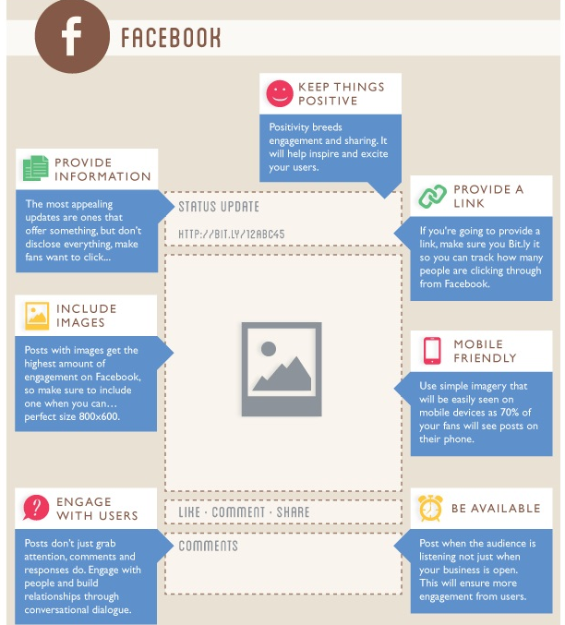
Facebook – Quick Infographic Guide

Slide 22
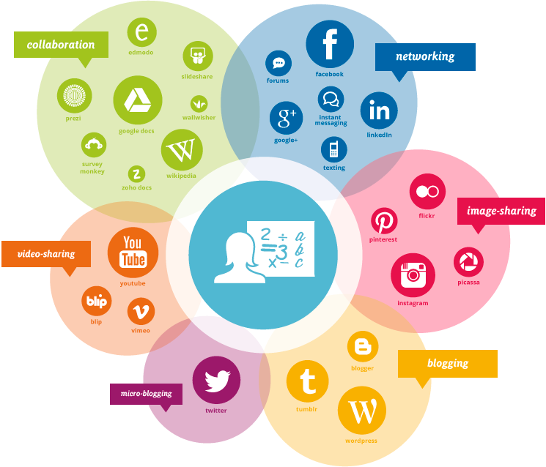
Other Social Media Platforms

Slide 23
Other social media channels
Snapchat is a messaging service where you can send a photo or video to a controlled list of recipients. These messages are known as ‘snaps’ and you can add text or drawings to them. The users determine how long recipients see their ‘snaps’ for (between 1 and 10 seconds). After this time the ‘snap’ is removed from the recipients device. This social media channel is particularly popular with 18-25 year olds.
Viber is a mobile application that allows you to make phone calls and send text messages free to other viber users. You can send messages to defined groups of people also.

Slide 24
Other social media channels
Whatsapp is a messaging service very similar to Viber that allows you to make phone calls and send text messages to other Whatsapp users free of charge. You can send messages to defined groups of people also. Whatsapp is popular with a younger demographic.
You Tube is a video sharing website that allows people to upload and view videos. You can set up your own account or a brand channel. You can subscribe to pages or users you like and also set up playlists of your favourite videos. You Tube is owned by Google and there are a number of advertising solutions available on the platform.

Slide 25
Other social media channels
Instagram allows its users to take photos and videos and share them across a number of social networks including Facebook, Twitter, Tumblr and Flickr. The user can apply a number of photographic filters to the image and a distinctive feature is that it confines photos to a square shape. The maximum duration for Instagram videos is 15 seconds. Instagram was acquired by Facebook in 2012 but have yet to fully launch advertising on the platform.
Google+ is Googles social media network. Some of the key features of Google+ include Circles which allows users to organise connections into groups or lists for sharing. Another feature is Hangouts which is a free video conferencing faciltiy for up to 10 people. Google+ has a +1 button similar to the Facebook Like which allows people to recommend sites or parts of sites.

Slide 26
Other social media channels
Pinterest is an online pinboard that allows users to curate content from across the web into collections. Users can ‘pin’ images and videos and then manage, view and sort them. You can also repin content from other users pinboards.
Flickr (pronounced "flicker") is an image & video hosting website. In addition to being a popular website for users to share and embed personal photographs, and effectively an online community, the service is widely used by photo researchers and by bloggers to host images that they embed in blogs and social media.

