Slide 1
Digital & Social Media Awareness Session
HSE Communications
5th November 2015
#hsemasterclass

Slide 2
1
2
3
Global & Irish trends across digital & social media
What are the benefits of social platforms?
How can you use social media?

Slide 3
Global & Irish trends across digital & social media
1

Slide 4
So what is this thing called digital?

Slide 5
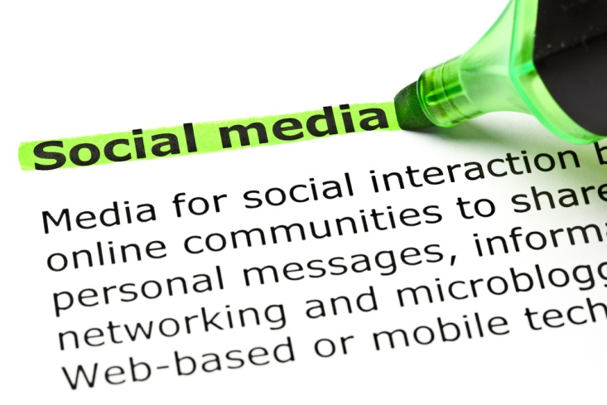

Slide 6
What Happens Online in 60 secs?

Slide 7
% Of Population on Social Media Network
Proportion of users that use the site network daily
59%
67%
28%
39%
Social Media in Ireland
23%
15%
21%
25%
19%
47%
14%
20%

Slide 8
What are the benefits of social platforms?
2

Slide 9
Sharing content – knowledge and information
Why Social?
Managing networks – connection with others

Slide 10
No filter
Listen & observe
Engage directly
Challenge misinformation
Openess and transparency
Credibility & trust
Data
What does social allow you to do?
Notes:
Why should any of us use social media?
Connectedness, information sharing, learning, leading, listening
If used properly can bring huge benefits in our personal and professional lives
Diabetes – self care, across the globe
Public health outbreak – communication at scale quickly
Engaging with staff
Leading – visibility, openness, challenging misinformation
Listening to what staff, colleagues, peers, influencers nationally and internationally are saying
Biggest signposter for online content – its where people go to find out info
Allows you to stay up to speed, informed and connected…
Photo sharing sites are continuing to grow; 19% of Irish People have signed up to Instagram
Communication anytime, anywhere & anyhow
80% of Facebook users are accessing the site via mobile
For the first time this qtr Facebook has lost popularity…..

Slide 11
10 Twitter Handles
10 Facebook Accounts
1 You Tube Channel
The HSE Social Footprint
26K+ Twitter Followers
Almost 200K Fans
250K +Views in 2015

Slide 12
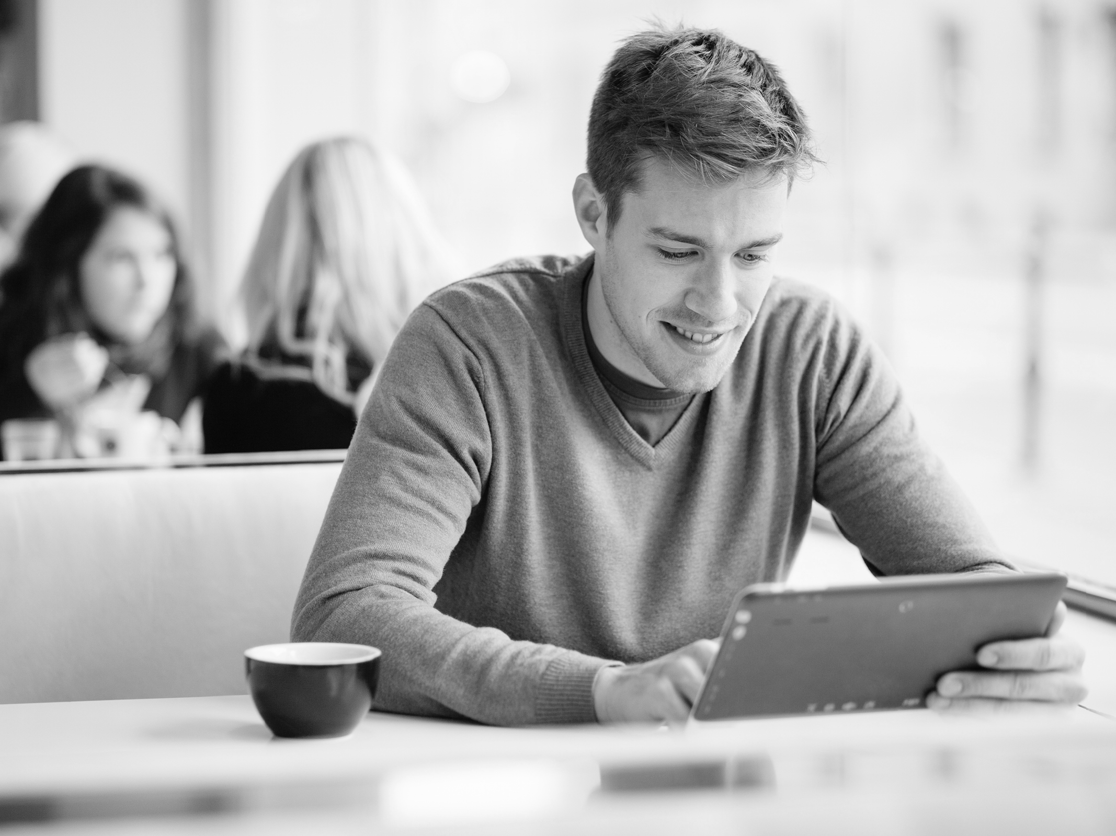
9.6m visitors since Jan 2015
@hselive top 200 followers reach 16 million
Communication at
scale quickly
HSE Digital & Social Summary
Over 70% organic traffic from Google
65% mobile & tablet traffic
Notes:
HSE.ie - 7.5 million visitors since Jan 2015
@HSELive top 200 twitter followers have over 16 million followers
Over 70% organic traffic i.e. comes directly from Google searches
60% visitors are using a mobile or tablet
The most visited pages on the website are:
Job Search
GP Visit Card Under 6s
Medical Cards
European Health Insurance Card
Online Payslips
Talk about data and how we use it here
Social media is the biggest signposter for online content

Slide 13
How can you use social media?
3

Slide 14
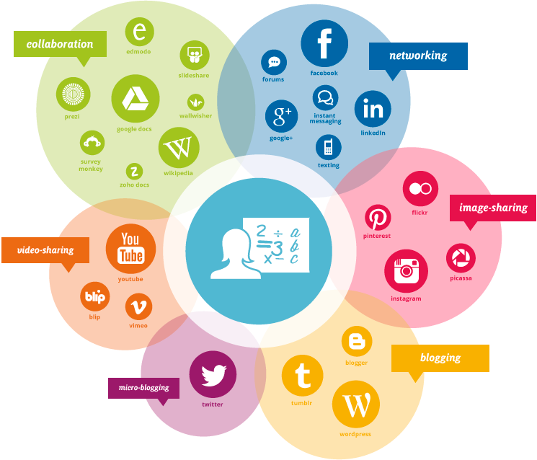
Social Media Channels
Notes:
Talk through that there are many social channels but we will cover 3 of the main ones today.

Slide 15
Twitter is the ‘live news’ stream social media channel, with each update allowing for only 140 characters
A tweet can contain text, a photo, a video or a link to another website
Twitter is widely used by influencers – from celebrities to the media, politicians and organisations
Twitter in a nutshell

Slide 16
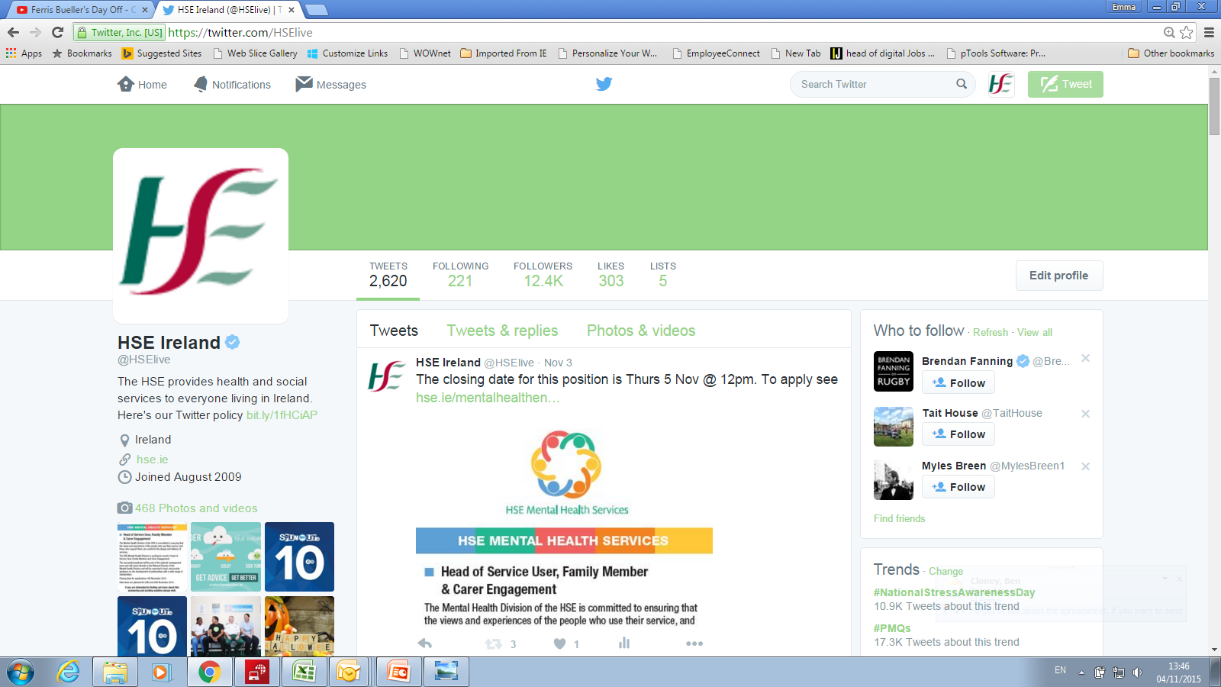
Get the Lingo

Slide 17
Get the Lingo

Slide 18
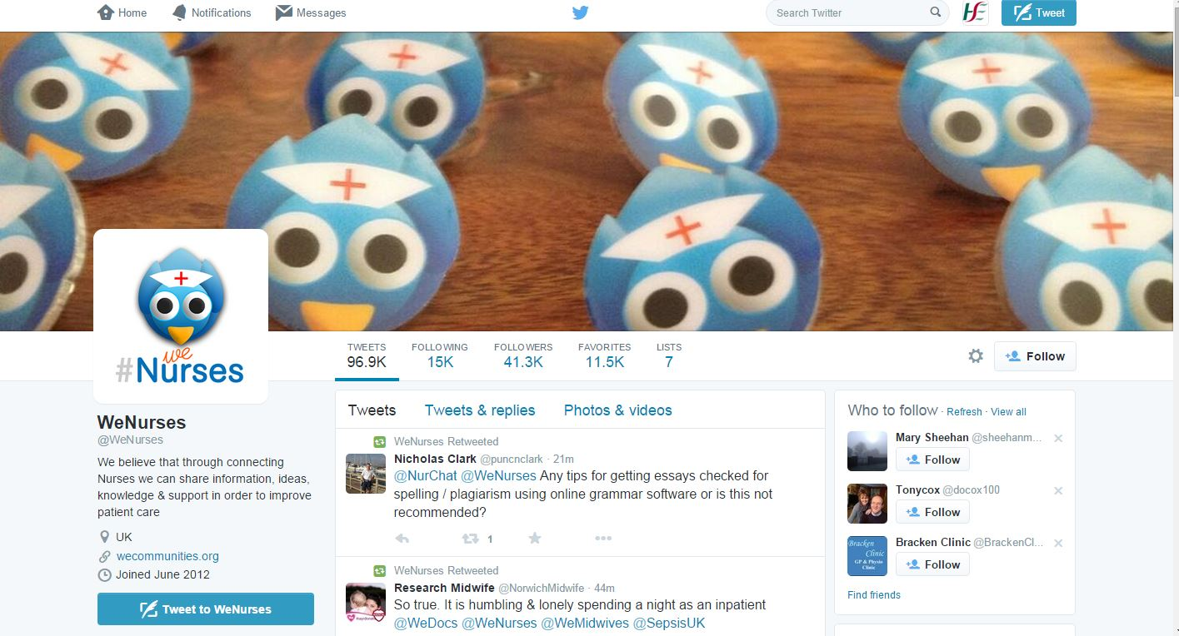
@WeNurses – UK Twitter account for nurses to connect
41.3k followers
Twitter bio:
We believe that through connecting Nurses we can share information, ideas, knowledge & support in order to improve patient care
@wenurses

Slide 19
@butNHS –talking about the great things about the NHS
50.6k followers
Patient outcomes are influenced by expectations. Unjustified negative press not only damages the NHS, it causes real harm to real people. I will RT good news.
@butNHS

Slide 20
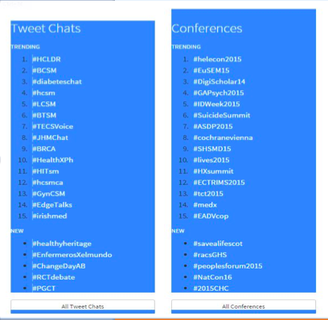
www.symplur.com is a website for all health related hashtags – it details tweet chats, conferences, diseases and what’s currently trending.
https://prezi.com/dxjhh3cp3ytb/social-media-what-it-offers-you-in-engagement-with-patients-and-communities/
The Healthcare
# Project
Symplur.com

Slide 21
“ If you want to connect with people and be part of their community, you need to go where the community is.”
Ed Bennett, University of Maryland Medical Centre –
A Facebook message can contain text, video, photos, links to other websites
Facebook is a closed platform so you must be ‘friends’ with someone to see their content but you must review your security settings. Or you can like a brand page.
Facebook in a nutshell

Slide 22
Get the Lingo
Notes:
Discoverable – people can search for your service online
Connected – you can have one-to-one conversations, people can read your posts, like your posts and share them with friends
Timely – your page can reach large groups of people in a short space of time
Insightful – analytics on your page can give you a deeper understanding of your target audience
Facebook uses algorithms – this means that the stories that show in your News Feed are influenced by your connections and activity on Facebook.

Slide 23
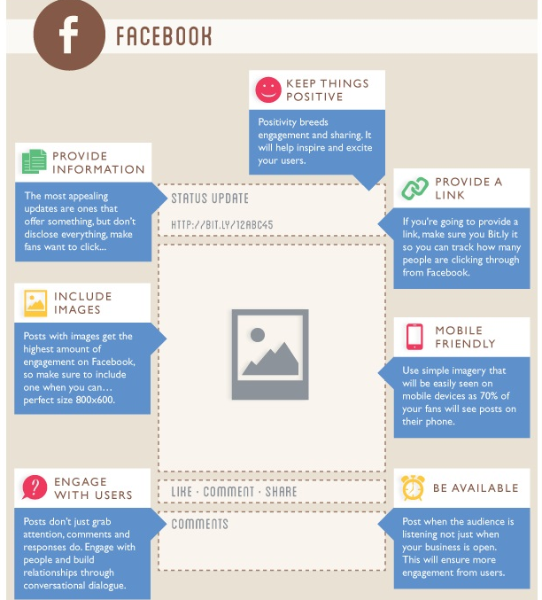
Get the Lingo

Slide 24
Quit Campaign

Slide 25
GP Visit Card Under 6 Launch
Under 6 social Media Coverage –Daily Volume June – July 2015

Slide 26
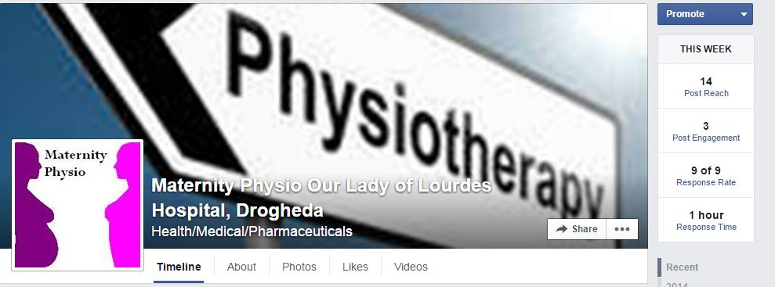
Our Lady of Lourdes, Drogheda – Maternity Physio

Slide 27
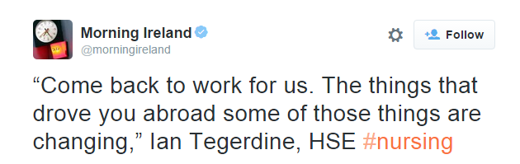
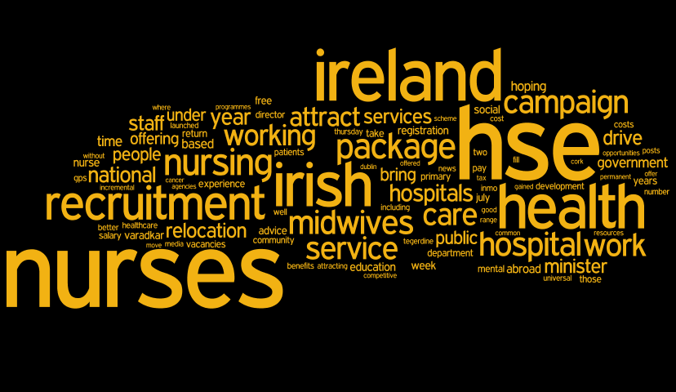
Human Resources Division- Nurse Recruitment Campaign

Slide 28
LinkedIn is an online social network for professionals.
It's designed specifically for professional networking.
You can find a job or someone can find you
You can discover sales leads
You can connect with colleagues & potential business partners
Linkedin in a nutshell

Slide 29
Get the Lingo

Slide 30
Get the Lingo

Slide 31
LinkedIn Groups are a great way for healthcare professionals to network and share industry knowledge.
There are a number of Irish healthcare groups on LinkedIn:
Connected Health Ireland
A platform to discuss the emerging Connected Health area
Mental Health Ireland Network
Forum to learn, and share ideas about improving Irish Mental Health Services
Occupational Health Ireland
Forum to learn and share information and resources about occupational therapy
Allied Health Professionals Ireland
An environment to seek and give advice on all aspects of the work of allied health professionals in Ireland
Linkedin Health Networks

Slide 32
Decide your purpose and select the right tool
Be authentic – be a human!
Remember it’s a conversation – that means two way
You are what you tweet....its all public
Practice makes perfect – give it a try
Be respectful – it’s the real world
Some final thoughts

Slide 33
Some food for thought….

Slide 34
Thank you!
www.hse.ie | @hselive | youtube.com/HSEIreland
Emma Finn - @finnster81 - ie.linkedin.com/in/emmafinn81
Kirsten Connolly - @kirstenconnolly
www.hse.ie/socialmedia

