Slide 1
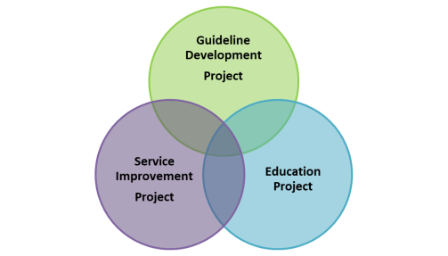
Irish National Early Warning System (NEWS)NCEC NCG 2013
Using NEWS

Slide 2
Welcome to the NEWS
The NCEC National Clinical Guideline (NCG) No.1 NEWS was introduced into acute hospitals in 2013
NCG No.1 NEWS (2013) is currently in use in Irish hospitals
The revised guideline – which will become INEWS – (Irish National Early Warning System) will be published in June 2020
NEWS is an adjunct to clinical judgement and is used to support the clinician in recognising and responding to the deteriorating patient; NEWS does not supersede clinical judgement

Slide 3
Aim and Audience
The purpose of this presentation is to provide information about how to use NEWS for staff in acute settings who may not previously have used NEWS or may not be familiar with NEWS.

Slide 4
Learning Outcomes
When you finish this presentation you should be able to:
Use NEWS to help you identify a patient who may be acutely unwell and deteriorating
Navigate the NEWS observations chart and use it to record, track and trend clinical observations and escalate patient care appropriately if required
Recognise the role of ISBAR in effective communication
Note: You will need to familiarise yourself with your hospital’s NEWS escalation and response protocol

Slide 5
What is NEWS? What is it for?
NEWS is an early warning system used in the care of the non-pregnant adult (≥16 years) patient in the acute setting.
NEWS is a system that facilitates the timely assessment of and response to the deterioration of acutely ill patients by:
Assisting in classifying the severity of a patient’s condition
Providing prompts and structured communication tools to escalate care

Slide 6
What is NEWS? What is it for?
NEWS as a system encompasses the anticipation, recognition, assessment, escalation, response and evaluation of the deteriorating patient.
NEWS consists of:
Clinical judgement (anticipation, recognition and assessment)
A track and trigger tool (the NEWS observation chart)(recognition and assessment)
An escalation and response protocol (escalation for nursing or medical review and structured appropriate clinical response mechanism)
Closed loop governance (evaluation of patient and process)

Slide 7
NEWS is of benefit in clinical practice for the following reasons:
NEWS provides a single standardised early warning system for the early detection of acute deterioration in the non-pregnant adult (≥16 years) patient
It provides a common language to aid communication between health care providers
It provides an adjunct to clinical judgement in the identification, assessment, escalation and response to clinical deterioration
It provides a standardised score to determine illness severity to support clinical decision making and an appropriate clinical response
It supports an anticipatory care approach to the management of the acutely unwell patient
It can help to improve the timely recognition and response to deteriorating patients

Slide 8
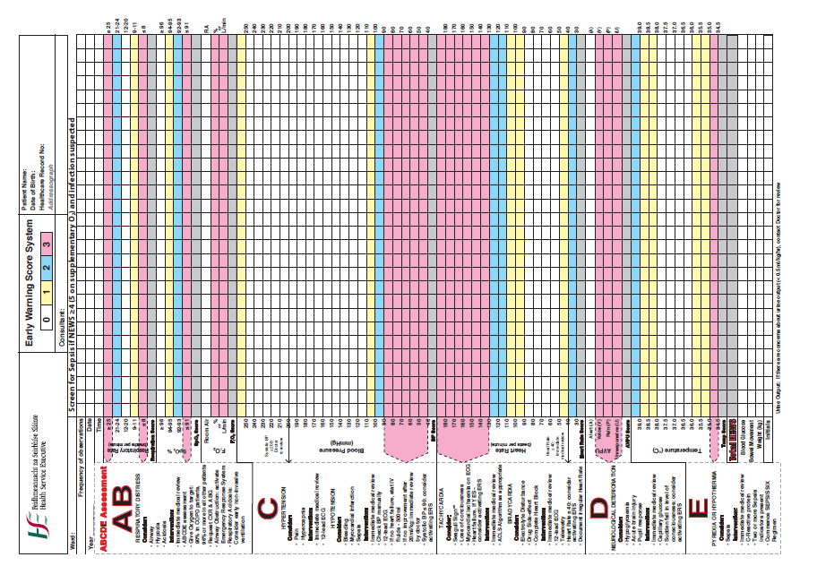
Introduction to the NEWS observations chart (track and trigger tool)
The NEWS chart provides a system for:
Recording NEWS physiological observations
Alerting staff when these physiological observations fall outside accepted ranges
Prompting escalation of care and clinical review.

Slide 9
Key elements of NEWS chart
The NEWS physiological parameter scoring key
The NEWS observation record
An Escalation and Response Protocol
A prompt to assist in the recognition of suspected sepsis

Slide 10
NEWS Scoring Key
The NEWS physiological parameters scoring key describes the evidence-based ranges which are considered normal and abnormal for the NEWS physiological parameters.

Slide 11
The NEWS observation record
The middle pages of the NEWS chart are for recording patient observations

Slide 12
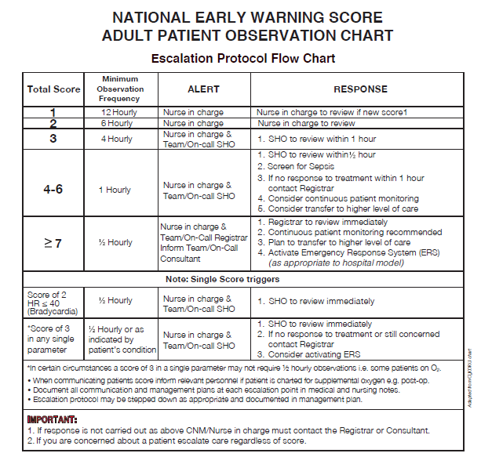
NEWS Escalation and Response Protocol
The NEWS Escalation and Response Protocol outlines what should be done at what scores and who should be called and when (please familiarise yourself with your hospital’s NEWS Escalation and Response Protocol)

Slide 13
Sepsis prompt
Consider sepsis if a patient’s NEWS score is ≥ 4 (or 5 on supplementary oxygen) and infection is suspected.
This prompt is usually seen in 2 places on the chart:
On the NEWS Escalation and Response Protocol under the ‘response’ column for NEWS scores of 4 – 6
On the back of the NEWS chart as part of the sepsis screening pathway

Slide 14
ISBAR
ISBAR should be used to frame all communication about a deteriorating patient
I (Identify) Identify yourself
S (Situation) Describe the situation
B (Background) Provide background information
A (Assessment) provide your assessment of the clinical condition and situation
R (Recommend) Tell the nurse in charge or doctor what your recommendation is and what you need them to do

Slide 15
The NEWS physiological observations are:
Respiratory rate
Oxygen saturation (SpO2)
Room air or Supplemental O2
Heart rate
Systolic blood pressure (SBP)
AVPU
(New confusion ( C ) is not currently captured on the NEWS chart but it is important to keep in mind that ‘new confusion’ is a key early indicator of deterioration; AVPU will become ACVPU in INEWS 2020 where C = new confusion/altered mental status/delirium)
Temperature
A full set of NEWS observations is recorded each time.

Slide 16
The following slides show you how to complete a NEWS chart and obtain a patient’s NEWS score

Slide 17
Completing the NEWS chart
Insert the patient’s addressograph
Document date, time, ward and the patient’s Consultant name
Document required ‘frequency of observations’

Slide 18
NEWS allocates a value of 0, 1, 2 or 3 to each of the seven NEWS observations.
A value of 0 is given for observations within normal ranges (as defined by the NEWS scoring key)
Values of 1, 2 or 3 are given for observations which vary from the normal ranges. Higher values indicate more severe variation.
The NEWS chart is colour coded –
NEWS value of 0 = white
NEWS value of 1 = yellow
NEWS value of 2 = blue
NEWS value of 3 = pink
The NEWS observations also include supplemental oxygen - a value of 0 is given for ‘room air’ and a value of 3 for ‘any O2’
0 | 1 | 2 | 3

Slide 19
Respiratory Rate
Changes in a patient’s respiratory rate is one of the earliest indicators of deterioration
Visually observe or auscultate the chest and count the patient’s respiratory rate (RR) for 60 seconds
Record the RR per minute on the chart as a number e.g. 19, 20, 21
Enter the NEWS value (0,1,2 or 3) for the RR into the grey row below the RR section

Slide 20
Peripheral Oxygen saturation (SpO2)
The peripheral O2 saturation (SpO2) is recorded in this section as a percentage e.g 95%
Enter the appropriate NEWS value (0,1,2 or 3) for SpO2 into the grey row below the SpO2 section
Consider:
The patient’s SpO2 % relative to supplemental O2 therapy
A new or increased O2 requirement is an early sign of deterioration
NEWS identifies normal SpO2 as ≥96%
Patients with confirmed chronic respiratory conditions may have lower baseline SpO2 levels.

Slide 21
SpO2 measurement using pulse oximetry may be affected by:
Nail polish or synthetic nails
Poor peripheral perfusion
Cardiac arrhythmias such as atrial fibrillation
Recording BP on the same arm as the pulse oximeter
Shivering or restlessness
Inappropriately sized probes or dirty probe sensors
Anaemia
Hypothermia

Slide 22
Room Air/Supplemental Oxygen
A new oxygen requirement or an increasing oxygen requirement is a significant sign of deterioration
Enter the appropriate NEWS value (‘0’ for ‘Room air’ / ‘3’ for ‘any O2’) into the grey row below this section
If a patient is on any inspired oxygen a NEWS value of 3 is given
Consider
If O2 is prescribed, the target SpO2 for the patient should be written on the drug chart
Aim for lowest amount of oxygen to achieve patient’s target SpO2
All deteriorating patients should be positioned appropriately and receive oxygen as an immediate measure before further assessment

Slide 23
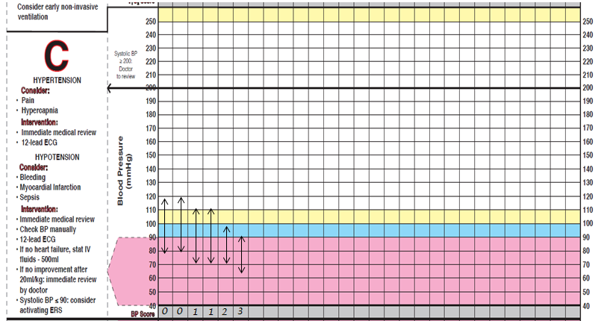
Blood Pressure
Record the BP as two closed arrows connected by a dotted line
The NEWS value applies to the Systolic BP (SBP) – look to see what colour the SBP arrow lies within (white, yellow, blue or pink) and score accordingly
Enter the appropriate NEWS value (0, 1, 2 or 3) for the Systolic BP into the grey row below this section
Notes:
Insert correct chart

Slide 24
Heart rate
Assess the patient’s heart rate by palpating and counting for 60 seconds.
Digital monitoring can be used to measure the heart rate, but good practice would suggest that manual assessment is used to determine amplitude, volume and regularity
Record the heart rate as a dot; indicate HR trend as a solid line connecting dots
Enter the appropriate NEWS value (0,1,2 or 3) into the grey row below the HR section

Slide 25
Neurological response
AVPU is the scale used to determine neurological deterioration. AVPU is:
Alert: Patient is alert and oriented to person, place, time and event.
Voice : The patient responds to verbal stimuli
Pain: The patient responds to painful stimuli with a purposeful or non-purposeful movement.
Unresponsive: The patient does not respond to stimuli.

Slide 26
Neurological response
A value of ‘0’ is given for ‘Alert’ and a value of 3 for anything else ‘ie VPU.
Enter the appropriate NEWS value (0,1,2 or 3) into the grey row below the AVPU section
If value is 3 or you are concerned about the patient’s mental status consider completing a Glasgow Coma Scale
Note: AVPU will change to ACVPU (C = new confusion) in the revised NEWS 2020 as ‘new confusion’ is a key indicator of acute deterioration. Please keep this fact in mind when assessing patient.

Slide 27
Neurological response (contd.)
Minor change from orientated to new confusion is significant. Discuss patient’s baseline with family
Patient who is alert but confused needs immediate referral to a doctor.
Any change in ACVPU must be considered significant and must be acted on immediately.
Rule out hypoglycaemia – Check blood glucose in any confused, unconscious or fitting patient whether they are diabetic or not.
Assess using the Glasgow Coma Scale if needed

Slide 28
Temperature
Temperatures should be recorded at the appropriate site (oral, axilla, tympanic) according to your local guidelines.
Record the time of measurement and use of any antipyretic drugs (to lower temperature) according to local policy
Enter the appropriate NEWS value (0,1,2 or 3) into the grey row below the Temperature section

Slide 29
NEWS total and initials
To obtain a patient's NEWS Score add the value given to each of the seven NEWS observations and total them
Enter the total NEWS score into the ‘Total NEWS score’ row
Refer to the NEWS Escalation and Response Protocol on the front of the chart to determine next steps
If you are concerned about a patient escalate care regardless of NEWS score (i.e. low or no scores)
Insert your initials in the row provided at the bottom of the chart
Consider recording observation frequency, pain score, blood glucose, bowel movement and time within which patient should be reassessed
Nursing students on clinical placement have entries countersigned by a registered nurse (as per local policy).

Slide 30
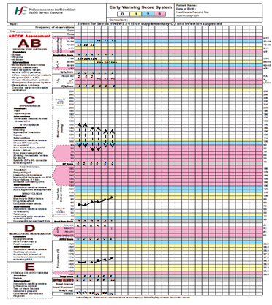
A completed NEWS chart

Slide 31
Escalation and response
Once you know the patient’s NEWS score, you may need to escalate care.
When thinking about who to escalate to, consult your local escalation and response protocol.
Communicate any triggers and/or concerns to the nurse in charge
Continue to monitor a patient pending and following escalation and review.

Slide 32
Nurse, Doctor, Patient , Family or Carer concern
While the NEWS observations chart does not currently capture nurse/doctor/patient/family concern it is an important indicator of patient deterioration.
If you as a nurse or doctor have concern about a patient care should be escalated regardless of NEWS score.
Of equal importance if the patient or their family have concerns about changes in the patient’s condition these concerns should be taken seriously by healthcare professionals and acted upon.
(Note: The revised INEWS 2020 observation chart will capture nurse/doctor/patient/family concern).

Slide 33
Other considerations
Depending on the patient’s clinical condition and your clinical judgement consideration may need to be given to clinical observations outside of the NEWS physiological parameters

Slide 34
Urine output
Decreased urine output is a sign of deterioration (<0.5mls/kg/hr)
Small window of opportunity to prevent acute renal failure
Escalate urgently to determine cause and commence treatment
Accurate fluid balance monitoring
Examining incontinence products for frequency of changing, colour and odour to assess fluid output

Slide 35
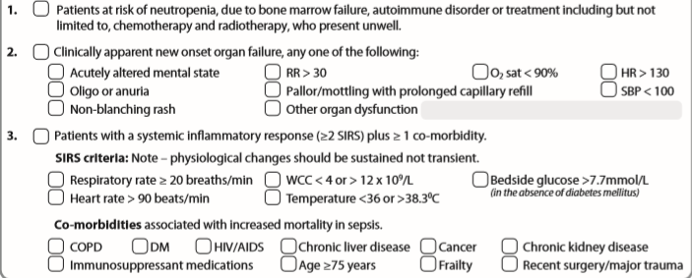
Sepsis
Consider sepsis if there is a suspicion of infection in a patient with a NEWS score ≥4 (or 5 if on oxygen) and/or
If the patient is in one of the 3 high-risk categories below:
Always use clinical judgement and escalate for medical review if there is deterioration in clinical condition due to an infection regardless of the NEWS score.
In some patient groups (including the elderly and those immunosuppressed due to a medical condition or medication), sepsis can initially be asymptomatic with an NEWS score of <4.

Slide 36
Other clinical observations
Additional observations depending on patient’s clinical condition may support the timely recognition of deterioration:
Fluid balance
Glasgow Coma Scale
Pain
Respiratory effort
Pallor
Capillary refill
Sweating
Nausea and vomiting

Slide 37
Summary
NEWS is an early warning system used in the care of the non-pregnant adult (≥16 years) patient in the acute setting.
NEWS is used to aid clinical judgement and clinical decision-making; if you are worried about a patient escalate care regardless of NEWS score
NEWS is a system that facilitates the timely assessment of and response to the deterioration of acutely ill patients by:
Assisting in classifying the severity of a patient’s condition
Providing prompts and structured communication tools to escalate care appropriately

