Slide 1
Managing Unreasonable Behaviour by Complainants within Your Service Your Say

Slide 2
Managing Unreasonable Behaviour by Complainants within Your Service Your Say Policy
Steering Group
CHO and Hospital Group Complaints Managers
Consumer Affairs
National Acute Operations
NCGLT
Health Service Trade Unions; SIPTU and INMO
HSE Human Resources
Patient Representatives: Patient Focus / Sage Advocacy

Slide 3
Managing Unreasonable Behaviour by Complainants within Your Service Your Say Policy
Programme of Work
Commenced in February 2018
Legal Review in April 2019
HSE Consultation from June to August 2019
Consideration of feedback by Steering Group in September 2019
Final documents prepared for Health Service Training Union approval in October 2019
Final approval to be sought from HSE Leadership
Notes:
Research: Definitions / Responses / Supports
Responses – imposing conditions or restrictions
Legal Review
Guidance and letter templates

Slide 4
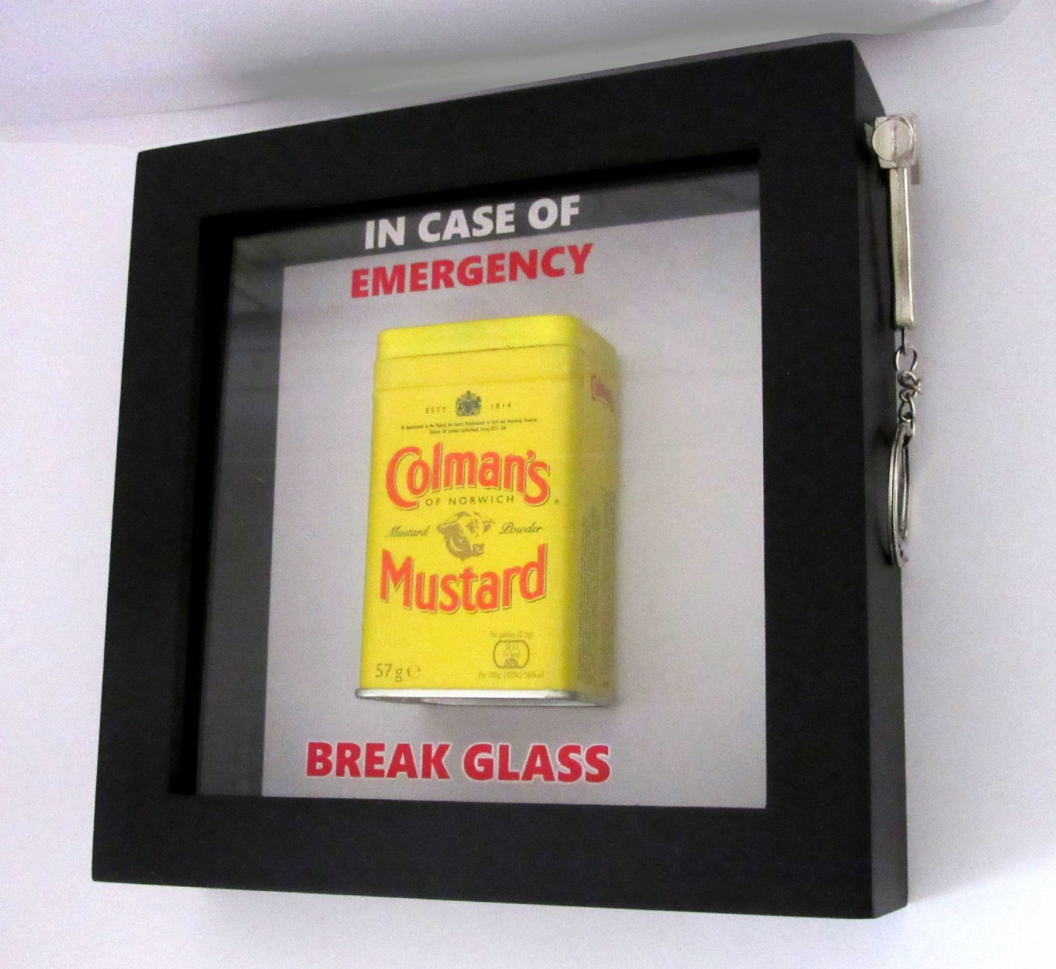
When to use Policy. . .

Slide 5
Managing Unreasonable Behaviour by Complainants within Your Service Your Say Policy
Replaces the 2008 HSE Policy for Dealing with Vexatious Complaints
Used only in exceptional cases where all reasonable steps have been taken to support and maintain the relationship
Does not supersede policies such as the HSE Management of Work-Related Aggression and Violence in cases of risk to the safety and welfare of staff

Slide 6
Managing Unreasonable Behaviour by Complainants within Your Service Your Say Policy
Policy Purpose
Ensure that both service users and staff are respected when engaged in the feedback process
Provide guidance on supporting and managing complainant relationships within YSYS
Provide clear procedure to respond to unreasonable behaviour

Slide 7
Managing Unreasonable Behaviour by Complainants within Your Service Your Say Policy
Policy Exemptions
Not intended as a policy for managing unreasonable behaviour by service users when generally availing of healthcare services
Not intended as a policy for managing unreasonable behaviour by staff

Slide 8
Supporting and maintaining
positive relationships
Adopt the best practice principles of complaints handling
Practice effective Communication Skills
Safeguard staff welfare – highlight available supports either informally through colleagues or Line Manager or more formally through the Employee Assistance Programme / Occupational Health, etc.
Notes:
Covered in YSYS CO training: Listening skills / Empathy / Questioning /Body Language / Tone of voice
Setting and Managing Expectations
Managing stress – theirs and yours
Emotional awareness (awareness of feelings/emotions involved in complaint and validating these)
Patience
Understanding triggers (yours and theirs)
Establish and understand underlying factors
Apology
Values in Action
De-escalation techniques
Managing challenging behaviour – positive behaviour support
Understanding anger / diffuse complainant anger

Slide 9
Definition of Unreasonable Behaviour
Unreasonable behaviour by complainants, whether experienced or observed, is that which has a disproportionate and unreasonable impact on the organisation (staff, services, time or resources) or which compromises the health, safety and security of staff and other service users or the complainant themselves.
It can, in most cases, be broadly grouped into five categories.
Notes:
Some of these included in the YSYS CO Training
Based on the NSW Ombudsman’s Unreasonable Complainant Conduct Policy
Ombudsman’s Unreasonable Complainant Conduct Policy / OCO Unreasonable Actions Policy

Slide 10
Definition of Unreasonable Behaviour
Unreasonable Persistence
Continued, incessant or unrelenting conduct by a complainant that is having a disproportionate and unreasonable impact on the organisation: staff, services, time and resources.
Insisting a complaint is investigated/ reviewed by a different officer, re-framing a complaint, persevering with argument or concerns that have already been addressed
Notes:
Based on Irish Ombudsman’s definition of unreasonable behaviour
Based on New South Wales Ombudsman’s definition of unreasonable behaviour

Slide 11
Definition of Unreasonable Behaviour
Unreasonable Demands
Any demands whether expressed or implied that are made by a complainant that have a disproportionate and unreasonable impact on the organisation: staff, services, time and resources.
Demand for an investigation outside the remit of YSYS, repeated demands for reviews, seeking a disproportionate remedy, trying to dictate how an investigation is handled
Notes:
Based on Irish Ombudsman’s definition of unreasonable behaviour
Based on New South Wales Ombudsman’s definition of unreasonable behaviour

Slide 12
Definition of Unreasonable Behaviour
Unreasonable Lack of Cooperation
An unwillingness and or/inability by a complainant to cooperate with the organisation, staff or complaints management process that results in a disproportionate and unreasonable impact on the organisation, staff, services, time and resources.
Presenting voluminous, irrelevant or disorganised material, changing complaint in the middle of the investigation, misrepresenting facts

Slide 13
Definition of Unreasonable Behaviour
Unreasonable Viewpoint
Any views or opinions that are not based in reason and/or logic, that are incomprehensible, false or inflammatory or trivial and that disproportionately and unreasonably impact on the organisation, staff, services, time and resources.
Exaggerating issues, presenting unreasonable arguments, focus on small issues, refusal to consider other version of events, desire for retribution, holding a grudge, presenting inaccurate, false or inflammatory information

Slide 14
Definition of Unreasonable Behaviour
Unreasonable Conduct
Conduct that is unreasonable even given the level of stress, anger or frustration that a complainant may be experiencing as it compromises the health, safety and security of staff and other service users or the complainant themselves.
Rude, aggressive, threatening or violent behaviour above what might be expected in situation

Slide 15
Procedure
Informal Resolution (as per YSYS policy)
Escalation
Assessment Phase
Escalation Phase One: Formal Warning Notice
Escalation Phase Two: Final Notice
Right of Appeal
HSE
Ombudsman /Ombudsman for Children

Slide 16
Procedure
Informal Resolution
Welcome feedback
Attempt to resolve issue at POC
Support positive engagement
Practice effective communication skills
Record any incidents
Escalate to Stage Two if unresolved at Stage One

Slide 17
Procedure
Escalation by Complaints Officer / Review Officer:
Assessment Phase
Complete Unreasonable Behaviour Escalation Form including evidence log
Attach examples of behaviour referred to if documented evidence available e.g. copies of inappropriate correspondence
Refer to and discuss with local Consumer Affairs
Consumer Affairs to determine, within 10 working days, onward referral to Accountable Officer or recommend further support of complainant relationship

Slide 18
Procedure
Escalation Phase One – Formal Warning Notice
Accountable Officer to determine, within 10 working days, to issue a Formal Warning Notice or recommend further support of complainant relationship
Where Formal Warning Notice is issued, Accountable Officer to advise complainant of option to discuss Notice
Behaviour moderates – no further action
Continuation of unreasonable behaviour – escalation to Phase Two

Slide 19
Procedure
Escalation Phase Two – Final Notice
Accountable Officer to determine, within 10 working days, to issue a Final Notice or recommend further support of complainant relationship
Where Final Notice is issued, Accountable Officer to:
advise complainant of conditions or restrictions imposed
advise complainant of right of appeal

Slide 20
Procedure
Appeal
HSE
Submitted in writing, setting out grounds, within 10 working days from date of issue of Final Notice to Chief Officer / Chief Executive Officer / National Director / Director of NAS and determination made within 20 working days
Advise complainant of outcome of appeal including right to request a review of the administration of the policy from the Ombudsman /Ombudsman for Children

Slide 21
Procedure
Appeal
Ombudsman / Ombudsman for Children
Submitted as per the Ombudsman’s / Ombudsman for Children’s procedures following the appeal decision by the HSE

Slide 22
Supports
Guidance Manual
Letter Template Suite
Consumer Affairs

Slide 23
Thank you!

