Slide 1
Complaints Management System
Workshop for trainers of Complaints Officers
Oct 2019

Slide 2
Why use the CMS: The Francis Report
The Francis Report highlighted the role of using patient complaint data to improve patient safety.
Analysing data on negative patient experiences strengthens the ability of healthcare organisations to detect systematic problems in care.
Reader TW, Gillespie A, Roberts J. Patient complaints in healthcare systems: a systematic review and coding taxonomy. BMJ Qual Saf 2014;23:678-689.
Notes:
The Complaints Management System:
Key Benefits
Ability to track an event or complaint from discovery date/occurrence to resolution.
Captures full complaint and event documentation, filing and resolution details.

Slide 3
Why use the CMS: Learning to Get Better
Learning to Get Better: Recommendation 13.
The HSE should introduce a standard approach to implementing Your Service Your Say across the public health service. This should include ….standard categorisation of complaints … to allow for comparison on complaint handling, subjects and outcomes between hospitals and hospital groups.
Learning to Get Better: Recommendation 19.
A standardised information system for the recording of complaints, comments and compliments should be developed across the hospital groups.
Notes:
The Complaints Management System:
Key Benefits
Ability to track an event or complaint from discovery date/occurrence to resolution.
Captures full complaint and event documentation, filing and resolution details.

Slide 4
Learning to Get Better: Response
Learning to Get Better: Recommendation 13 and 19.
RESPONSE
The HSE has developed a Complaints Management System with an expanded HSE coding taxonomy based on a thematic analysis of the complaints to identify particular complaint issues. These now extend to 153 sub-categories.
E.g. Safe & Effective Care
Infection prevention and control
Non compliance with Infection and Control policies and protocols
Other international taxonomies are also being investigated.
Notes:
The Complaints Management System:
Key Benefits
Ability to track an event or complaint from discovery date/occurrence to resolution.
Captures full complaint and event documentation, filing and resolution details.

Slide 5
Benefits of a standardised information system
Complaint data can be used to identify problems:
when aggregated - potentially indicates problematic trends in healthcare provision.
enables systematic analysis and standardised investigative techniques - essential for learning from patient complaints.
can be used with a secondary data source.
the Complaints Management System is:
Standardised
Centralised
Web-based
Live! – Capturing live data on Stage 2 complaints.

Slide 6
The Complaints Management System supports
the quality assurance process of complaints management
The CMS is designed to completely support each step of Stage 2 of the complaints process
end-to-end complaint reporting
tracking of investigations, outcomes and recommendations
Notes:
The Complaints Management System:
enables learning from complaints locally, regionally and throughout the organisation,
provides HSE sites with end-to-end complaint reporting, enables all participating sites to report on, interrogate and interpret their data.
supports the tracking of investigations, outcomes and recommendations ,
is a critical part of the QA process in both complaints management,

Slide 7
CMS
Current Usage
Oct 2019

Slide 8
Usage to date 2019
Area | Recorded on CMS | All issues subject to legislation | No issues subject to legislation | Some issues subject to legislation | undefined |  | 2018 @ 18/09/2019 |  | Users Trained
CHO 1 | 35 | 24 | 11 |  |  |  | 6 |  | 37
CHO 2 | 3 | 3 |  |  |  |  | 10 |  | 17
CHO 3 | 42 | 41 |  |  | 1 |  | 84 |  | 7
CHO 4 | 50 | 25 | 9 | 15 | 1 |  | 80 |  | 99
CHO 5 | 22 | 15 |  |  | 7 |  | 57 |  | 49
CHO 6 | 50 | 49 | 1 |  |  |  | 21 |  | 51
CHO 7 | 69 | 67 | 0 | 2 |  |  | 5 |  | 36
CHO 8 | 55 | 40 | 5 | 9 | 1 |  | 127 |  | 87
CHO 9 | 54 | 18 | 18 | 18 |  |  | 128 |  | 93
RCSI | 689 | 560 | 51 | 71 | 7 |  | 702 |  | 38
DMHG | 170 | 168 | 1 | 1 |  |  | 165 |  | 36
IEHG | 191 | 81 | 72 | 36 | 2 |  | 235 |  | 17
SSWHG | 476 | 275 | 83 | 102 | 16 |  | 354 |  | 57
Saolta | 327 | 289 | 36 |  | 2 |  | 336 |  | 29
ULH | 468 | 453 | 5 | 2 | 8 |  | 517 |  | 22
NAS | 60 | 52 | 4 | 3 | 1 |  | 63 |  | 7
 | 2761 | 2160 | 296 | 259 | 46 |  | 2890

Slide 9
NCGLT Reports
NCGLT
Annual Report: Health Service Complaints Process Compliance
Annual Area Reports: Classification driven
Ad hoc Reports
CHOs/HGs
Scheduled Reports
Ad hoc Reports

Slide 10
Potential Scheduled Reports
Causes/Classification of complaints
The total number of complaints on-hand and pending
The total number of complaints received in a given month
The types of the complaints received (broken down into 243 categories)
Complaints and Reviews that result in a recommendation.
Recommendations implemented
Complaints excluded under Part 9 of the Health Act 2004
Complaints dealt with informally at Stage 2
Reviews resolved informally at stage 3
Complaints withdrawn at stage 2 or 3
Complaints dealt with within 30 working days at Stage 2
Complaints that took longer than 30 days to deal with at Stage 2
Reviews that were dealt with within 20 working days at Stage 3
Reviews that took longer than 20 working days at Stage 3
Complaints resolved through mediation

Slide 11
CMS
Steering Group
Oct 2019

Slide 12
CMS Steering Group
The CMS Steering Group has been established to provide governance and direction for the implementation and further development of agreed modules of the Complaints Management System. The group also functions as an approval committee and clearing house for change requests from users of the CMS before changes are then forwarded to the NIMS Steering Group.
Each member of the CMS Steering Group is a nominated CMS Lead and represents their own CHO or Hospital Groups current and future requirements with regard to complaints management and reporting on the CMS.

Slide 13
CMS Steering Group
During 2019:
the following changes have been made to the CMS
Extended division data
Onsite/Offsite
Incident date
The following pilots have been ongoing
Point-of-Contact Complaints Module
Positive Feedback Module

Slide 14
CMS
Data Quality Audit 2019 Oct 2019

Slide 15
2019 Data Quality Audit
During 2019 the NCGLT conducted a data quality audit of data that was recorded on the CMS during 2018.
2 CHOs recorded a small number of complaints that were assigned ‘closed’ dates but had not been actually closed out on the CMS. These were corrected in the final report.
2 HGs recorded a number of complaints that were assigned ‘closed’ dates but had not been actually closed out on the CMS. These were corrected in the final report.
In 2 Hospital Groups, in 5 Hospitals the legislative status of some complaints recorded was entered incorrectly to significant levels. This was corrected as the data entered was incorrect.
In 1 Hospital, it failed to record any associated issues.
In 1 Hospital Group, 3 Hospitals had such extensive inaccuracies in the data recorded that no further breakdown or analysis of complaints and issues for these hospitals was possible.
In 2 Hospital Group reports, data entered for 5 hospitals was so small, these Hospitals will not be examined.

Slide 16
2019 Data Quality Audit: General Findings
Staff involved in complaints investigations need a clearer understanding of which complaints fall under the Health Act, 2009.
Identified Hospitals and specific CHO services need refresher training.
Staff in identified areas need to use the CMS Support Form.

Slide 17
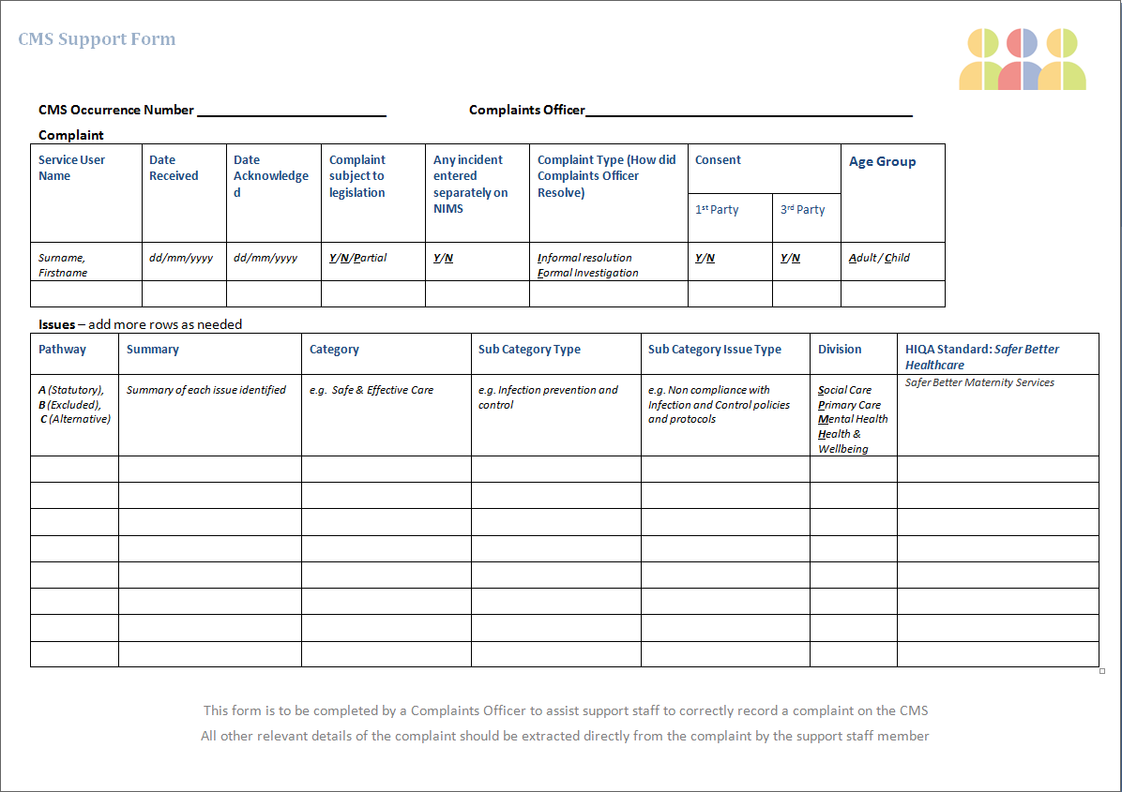
CMS Support Form

Slide 18
CMS 2018 Data:
What can we learn
Oct 2019

Slide 19
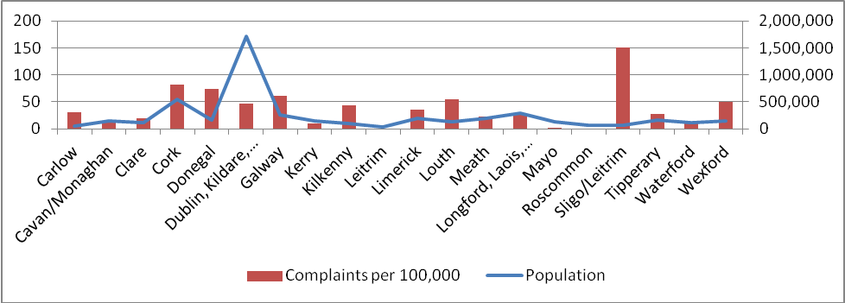
More detailed reporting capability
Figure 7: Breakdown of complaints recorded by Community Services per 100,000 general population / population per county

Slide 20
More detailed reporting capability
Complaints resolved by Complaints Officers either informally or formally within 30 working days against the target line of 75%

Slide 21
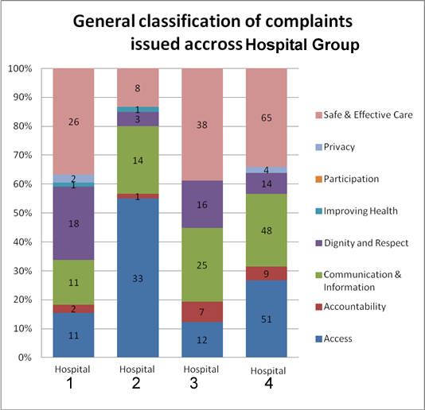
More detailed reporting capability

Slide 22
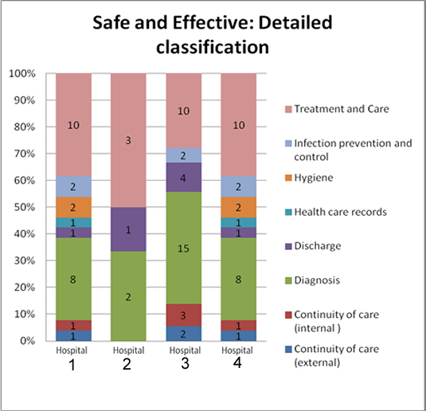
More detailed reporting capability

Slide 23
More detailed reporting capability
Hospital 1: Safe and Effective Care top 5
Issues | Sub Category Issue Type | Sub Category Type
5 | Failure / delay in treatment / delivery of care | Treatment and Care
4 | Diagnosis - misdiagnosis | Diagnosis
4 | Diagnosis - delayed diagnosis | Diagnosis
2 | Health Care Associated Infection | Infection prevention and control
2 | Cleanliness of area | Hygiene
Hospital 2: Safe and Effective Care top 5
Issues | Sub Category Issue Type | Sub Category Type
1 | Failure to provide a safe environment | Health and Safety issues
1 | Failure / delay in treatment / delivery of care | Treatment and Care
1 | Unsuccessful treatment or care | Treatment and Care
1 | Diagnosis - contradictory diagnosis | Diagnosis
1 | Unsatisfactory treatment or care | Treatment and Care

Slide 24
More detailed reporting capability
Hospital 3: Safe and Effective Care top 5
Issues | Sub Category Issue Type | Sub Category Type
7 | Diagnosis - delayed diagnosis | Diagnosis
5 | Diagnosis - contradictory diagnosis | Diagnosis
4 | Other | Discharge
3 | Diagnosis - misdiagnosis | Diagnosis
3 | Failure / delay in treatment / delivery of care | Treatment and Care
Hospital 4: Safe and Effective Care top 5
Issues | Sub Category Please Specify | Sub Category Type
21 | Other | Continuity of care (internal )
7 | Unsatisfactory treatment or care | Treatment and Care
6 | Diagnosis - delayed diagnosis | Diagnosis
5 | Other | Diagnosis
2 | Failure / delay in treatment / delivery of care | Treatment and Care

Slide 25
Using the CMS
DEMO
Oct 2019

Slide 28
Thank You

