Slide 1


Your Service Your Say
Presentation on
YSYS Guidance for Clinical Staff
1st October 2019
Sinead Kelleher NCGLT

Slide 2
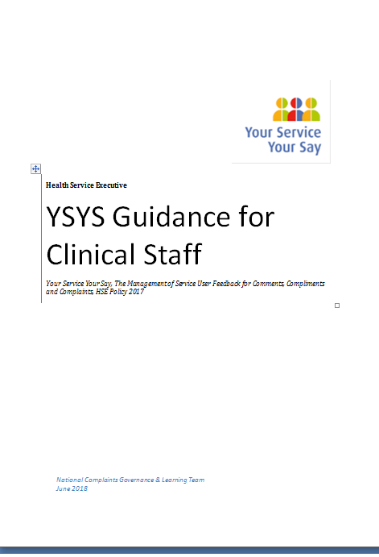
ecember 2018

Slide 3
YSYS Guidance for Clinical Staff
Why has this been developed?
This guidance has been developed to provide support to the various clinical professionals who may at some point be asked to contribute their views as part of a complaints investigation or to write a specific clinical report as part of the complaints investigation.

Slide 4
YSYS – Clinical Judgment
The Health Act 2004 defines clinical judgment as being:
“A decision made or opinion formed in connection with the diagnosis, care or treatment of a patient”
NOTE: Clinical judgment can be exercised by any of the recognised clinical professions, including Doctors, Nurses, Midwives, Dentists, Pharmacists, Optometrists, Clinical Psychologists, Ophthalmic Medical Practitioners, Allied Health Professionals, Emergency Medical Technicians, Laboratory, Environmental Health Officers, other scientific and technical staff.

Slide 5
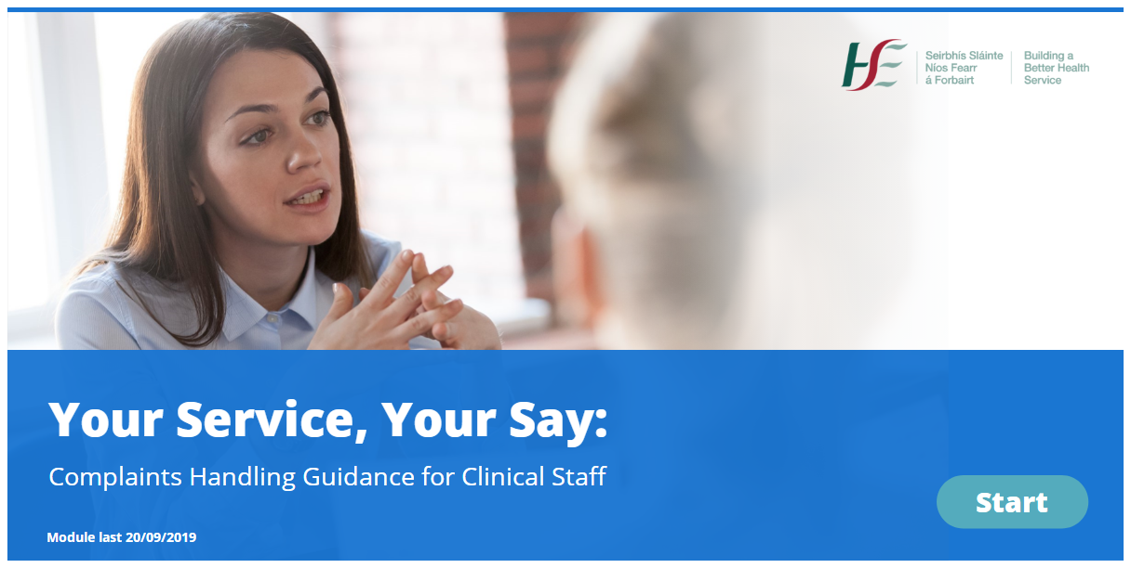

Your Service Your Say:
Complaints Handling Guidance for Clinical Staff

Slide 6
YSYS Complaints Handling Guidance for Clinical Staff
AIM:
This module will guide you through your involvement in the Your Service Your Say complaints process, encourage and assist you to engage with Service Users and outline the key elements of a Clinical Judgement Complaint Report.

Slide 7
Purpose
Outcomes:
By the end of the course you will be able to:
Fulfil your role in the Your Service Your Say complaints handling process, and describe your responsibilities within the legislative framework.
Work collaboratively with the Complaints Officer to effectively resolve complaints.
Communicate effectively with Service Users to respond appropriately to their concerns.
Write a clear clinical judgement complaint report in line with best practice to demonstrate to Service Users that their complaint has been heard and taken seriously.
Identify where complaints offer opportunities for learning, for yourself, your team and your organisation.

Slide 8
Content
 | Topic Title | Approximate Duration
TOPIC 1 | Setting the Scene | 15 minutes
TOPIC 2 | Undertaking Informal Resolution | 20 minutes
TOPIC 3 | Contributing to or conducting a Formal Investigation | 15 minutes
TOPIC 4 | Summary and Assessment | 10 minutes

Slide 9
Setting the Scene
Overview of the 4 stages of the complaints
Description of assessing a complaint and what is described as clinical elements within a complaint and non-clinical elements.
The role of Clinical staff in the complaints management process.
How Complaints Officers (CO) & clinical staff work together?
Overview of Informally investigating a complaint
Overview of the formal investigation phase: Clinical professional investigates CJI, writes Clinical Judgement Complaint Report & provides it to CO.

Slide 10
Setting the Scene
Setting the scene will incorporate a number of animations addressing the various types of concerns that a clinical professional may encounter before agreeing to meet a complainant:
This section is about addressing any fears and concerns clinical staff may have about being involved in informal resolution.
Learners will be presented reassuring messaging about how this module will prepare them to meet these challenges. E.g.
This module is giving you a structure to make this engagement easier. It will help you with communication skills and resilience.
Complaints are an opportunity for learning and improvement. Service users need to feel trust and confidence.

Slide 11

Setting the Scene
This module will show you how to effectively engage with complainants.
For face to face and telephone conversations, you can use the ASSIST model.
A: ACKNOWLEDGE, S: SORRY, S: STORY, I: INQUIRE, S: SOLUTIONS, T: TRAVEL
A: ACKNOWLEDGE: Consider in advance: What do you need to acknowledge to the service user?
S: SORRY: Consider: What do you need to say sorry for?
S: STORY: Provide an opportunity for the patient/service user/family to relate to you their understanding of what has happened including the impact the event has had on the and their feelings/concerns in relation to the event and their ongoing condition and care plan.
I: INQUIRE: Provide an opportunity for the patient/service user/family to ask questions.
S: SOLUTIONS: Seek the patient/service user/family’s ideas on the way forward.
T: TRAVEL: Avoid abandonment – Reassure them that their care going forward will not be compromised.

Slide 12
Topic 2: Undertaking Informal Resolution
Why Meet the Service User? Written complaint doesn’t mean you cannot try to resolve informally.
It could be resolved informally by meeting and discussing with the complainant, which could happen in person or over the phone.
Meeting = opportunity for complainant to voice concerns and explain issues more clearly; forum to discuss issues; it may be possible to resolve some/all complaint issues.
Possible outcomes are discussed in this topic:
Some or no YSYS resolved & some or no CJI resolved
All YSYS resolved & no CJI resolved
All YSYS resolved & all CJI resolved

Slide 13
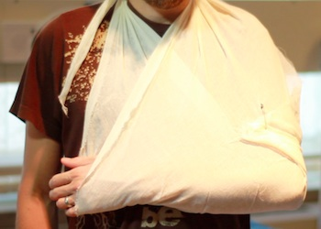
A Complaint is Made
SCENARIO 1: Consultant, acute setting

Slide 14
Preparing to meet the Complainant
Best practice preparation through interactive questioning and considerations.
This meeting is set on an interactive learning platform through the use of videoing a meeting in an acute setting with the different characters.
Best practice methods are highlighted here and the learners must decide on what the best practice approach is from a multiple choice.

Slide 15
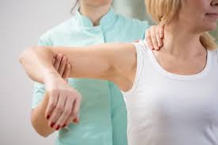
A Complaint is Made
Scenario 2: Physiotherapist Community Setting

Slide 16
Topic 3: Contributing to a Formal Investigation
In some situations, complaints are not resolved informally & complainant may want a formal investigation from the outset.
Overview of formal investigation steps for clinical staff:
Clinical professional:
Receives notification letter from Complaints Officer, requesting Clinical Judgement Complaint Report
Investigates Clinical Issues & updates Complaints Officer if more time needed.
Writes & signs a Clinical Judgement Complaint Report.
Provides report to Complaints Officer.

Slide 17
Topic 3: Contributing to a Formal Investigation
Writing a Clinical Judgement Complaint Report (CJCR)
This section will also include a video interview from a real consultant who has completed reports, and how they have found the process.
Clinical Judgment report structure
Do’s & Don’t in writing a report
Example’s of a well written report
Example’s of a poorly written report
Identified learning.

Slide 18

Assessment
Assessment at the end 5 questions
Must get 80% to pass.

Slide 19
Any Questions?

