Slide 1
Assisted Decision-Making (Capacity) Act 2015
Jacqueline Grogan
Project Manager, HSE Assisted Decision-Making and Consent Office
@jacqgrogan

Slide 2
What the presentation will cover?
About the Act
Key aspects about the Act
Guiding principles of the Act
Who are the legally recognised persons?
Update on what is happening

Slide 3
The journey to date
1871 Lunacy Act
2003 Who Decides & How
2003 The Law & the Elderly (LRC)
2005 Vulnerable Adults & the Law (LRC)
2007 Ireland signed the CRPD
2008 Mental Capacity & Guardianship Bill
2009 Bioethics – Advance Healthcare Directives (LRC)
2013 Assisted Decision-Making Bill
2015 Assisted Decision-Making (Capacity) Act
2018 Ratification of the UNCRPD

Slide 4
UN Convention on the Rights of Persons with Disabilities
Key requirements of Article 12 include:
Persons with disabilities have the right to recognition everywhere as persons before the law.
Persons with disabilities should enjoy legal capacity on an equal basis with others in all aspects of life.
Appropriate measures should be taken to provide access by persons with disabilities to the support they may require in exercising their legal capacity.

Slide 5
UN Convention on the Rights of Persons with Disabilities
All measures that relate to the exercise of legal capacity provide for appropriate and effective safeguards to prevent abuse in accordance with international human rights law. These safeguards must respect the will and preference of the person.
Appropriate measures should be taken to ensure the equal rights of persons with disabilities to own or inherit property, to control their own financial affairs

Slide 6
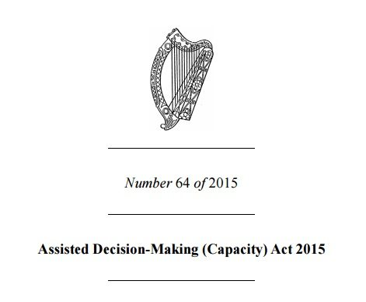
Assisted Decision-Making (Capacity) Act 2015
Signed by President – 30th December 2015
Some sections of the Act have commenced

Slide 7
Establishment of the Decision Support Service

Slide 8
Decision Support Service
Promote awareness of the Act
Provide information to people in relation to their options under the Act for exercising their capacity
Provide information to, and provide legal oversight of the legally recognised persons
Make recommendations to the Minister on any matter relating to the operation of the Act

Slide 9
Appointment of the Director of Decision Support Service

Slide 10
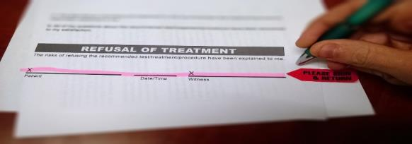
Multidisciplinary working group on Advance Healthcare Directives

Slide 11
Who is the legislation for?

Slide 12
Who in particular?
It applies to a person whose decision-making capacity is being called into question, may shortly be called into question, or lacks capacity, in respect of one or more than one matters.

Slide 13
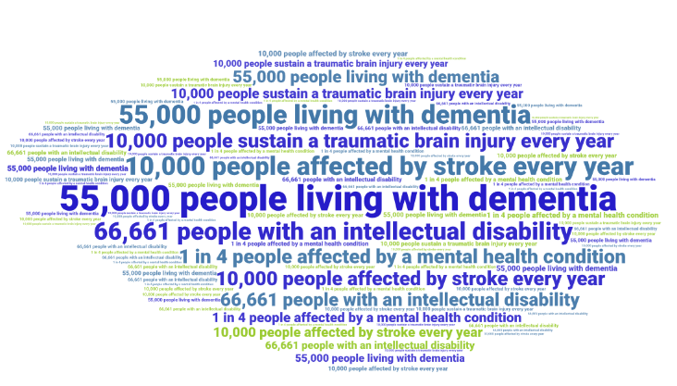
In Ireland….

Slide 14
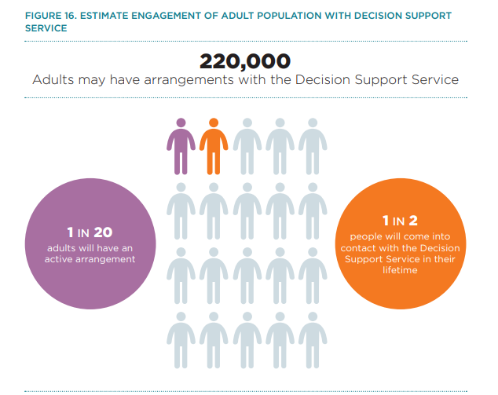

Slide 15
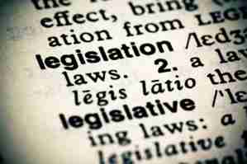
What does the Act say?
It requires service providers to provide a range of supports and information to help a person make a decision.

Slide 16
Important to remember
The ADMCA is a disability neutral Act
This reminds us that we all need support at some time and that at times, in certain situations, some people need more support!!

Slide 18
Presumption of capacity
It is presumed that the person has capacity to make their own decisions, unless it is proved otherwise

Slide 19
Support to make a decision
Everyone has the right to be supported to make decisions

Slide 20
Unwise decisions
A person cannot be considered as being unable to make a decision merely because they are making, have made, or are likely to make, an unwise decision

Slide 21
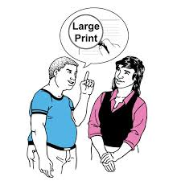
Accessible information
A person has the right to have accessible information in relation to a particular decision
More time to understand information
And information in a range of different formats to maximise understanding (eg easy to read, audio, video, text, pictures)

Slide 22
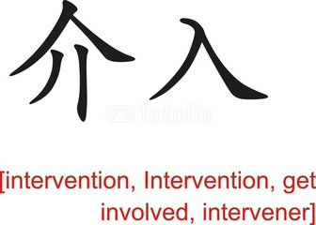
Legally recognised persons
The Act provides for legally recognised persons referred to as ‘interveners’ to support a person to maximise their decision making capacity

Slide 23
Retention for short periods
The ability to retain information for short periods only should not be equated to a lack of capacity

Slide 24
Least restrictive intervention
There shall be no intervention unless it is necessary to do so. Any intervention must be in a manner that:
Minimises any restrictions on a person’s rights and freedom of action
Is as limited in duration as possible
Is proportionate to the significance and urgency of the decision
Is for the benefit of the person

Slide 25
What is capacity?
Capacity is defined as the person’s ability to understand, at the time a decision is to be made, the nature and consequences of the decision to be made by him or her in the context of the available choices at that time

Slide 26
Moving from……
Status approach
You are someone with an intellectual disability or dementia or a brain injury and therefore, you cannot have capacity
Outcome approach
What you want to do is so unwise that you must lack the capacity to decide to do it

Slide 27
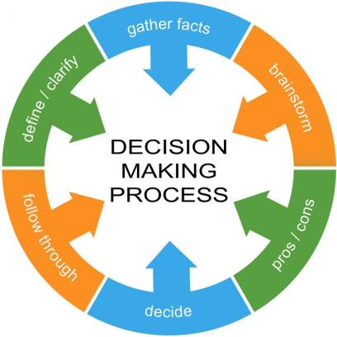
To this….
Functional approach
How the decision is made, not the outcome or consequence of the decision
Functional approach is issue, context and time specific

Slide 28
Functional assessment of capacity
The functional assessment states that a person is unable to make a decision for himself if he is unable:

Slide 29
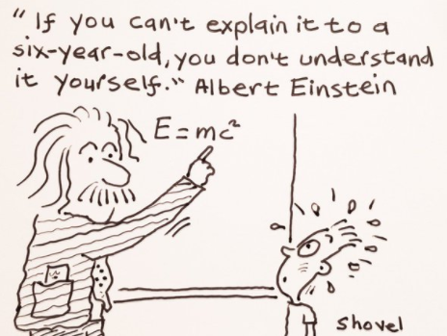
To understand the information relevant to the decision

Slide 30
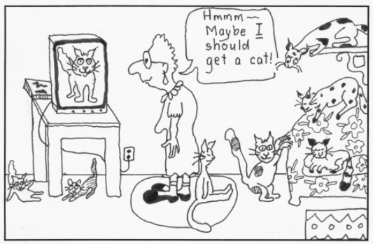
To retain that information for long enough to make a choice;

Slide 31
To use or weigh that information as part of the process of making the decision; or

Slide 32
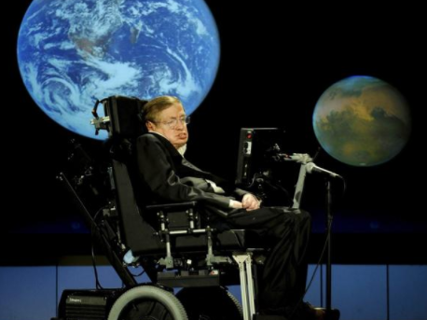
To communicate their decision (whether by talking, sign language, using technology or any other means).

Slide 33
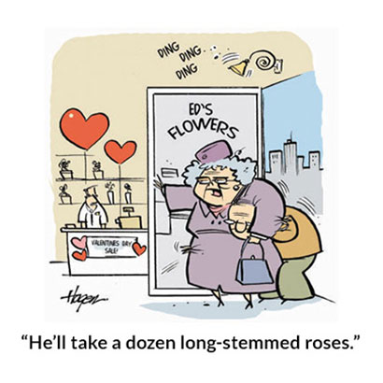
Will and preference
If there is concern that someone lacks capacity to make a decision, it is essential that their past will and preferences are taken into consideration

Slide 34
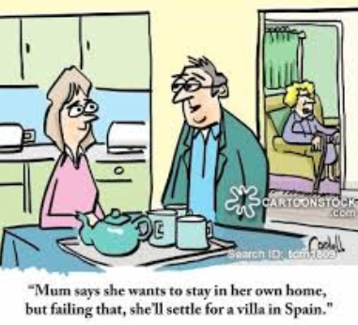
Need to consider…
What they would have wanted to happen before they lack capacity
Their beliefs and values

Slide 35
Wardship
Section 2, Lunacy Regulation 1871 Ireland Act
“….any person …. of unsound mind, and incapable of managing himself or his affairs”
People still being registered for Wardship (13 people per week)

Slide 36
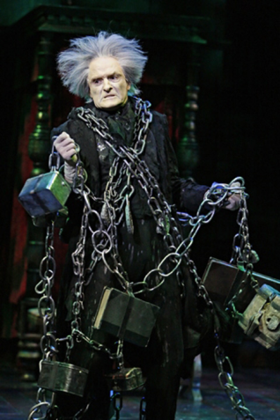
Abolition of Wards of Court
The Wards of Court system will be abolished.
There will be a review of all existing wards – they will be discharged fully and may be supported to transition into one of the new decision-making arrangements provided for under the Act.
This will happen within 3 years of the Act being commenced.

Slide 37
Who are the legally recognised persons?
Decision-Making Assistant
Co-Decision-Maker
Decision-Making Representative
Enduring Power of Attorney
Designated Healthcare Representative

Slide 38
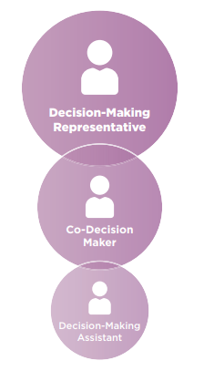
The 2015 Act sets out three different tiers of support that could be provided to a relevant person who is faced with capacity challenges:

Slide 39
Decision-Making Assistant
Lowest and least formal of all levels
Appointed by the person when they consider capacity is or may shortly be called into question
Helps access information, or support the person to understand, make or express decisions
Can make own decisions, requires support to do so
Decision is still made by the appointer

Slide 40
Decision-Making Assistant
A Decision Making Assistant is appointed through a formal Decision Making Assistance Agreement.
The Agreement may be revoked at any time by either party, or changed with the consent of both parties.
Director of the DSS is notified of the agreement

Slide 41
Co-Decision-Maker
Appointed by the person when they consider capacity is or may shortly be called into question
Make specified decisions jointly with the appointer
Suitable co-decision-maker – someone who knows the person well, like a close family friend or family member
Will and preference should be established

Slide 42
Co-Decision-Maker
Written agreement, two witnesses
Statement by a registered medical practitioner and such other healthcare professional as shall be prescribed that the appointer:
Has capacity to decide to enter co-decision-making agreement,
Requires assistance in exercising decision-making in respect of the relevant decisions in the agreement, and
Has capacity to make the relevant decisions specified in the co-decision-making agreement with the assistance of the co-decision-maker;
Registered and review by Director

Slide 43
Decision-Making Representative
Circuit Court
Application under Part 5 of the Act
Declaration of incapacity
Co-decision-maker will not suffice
Substituted decision-making
Court might make the decision if it is urgent or it is expedient to do so

Slide 44
Decision-Making Representative
Purpose - one or more specified decisions regarding a person’s
Personal welfare (including healthcare)
Property and affairs

Slide 45
Decision-Making Representative
Decision Making Representation Order
Powers must be limited in scope and duration
Only have the power to do what is in the order
Must consider if there is an EPA/AHD

Slide 46
Decision-Making Representative
In appointing Decision-Making Representative the court will have regard to:
The known will and preferences of the person
Desirability of preserving existing relationships within family
Relationship/Compatibility between the person and the proposed representative
Whether proposed representative will be able to perform functions
Any conflict of interest

Slide 47
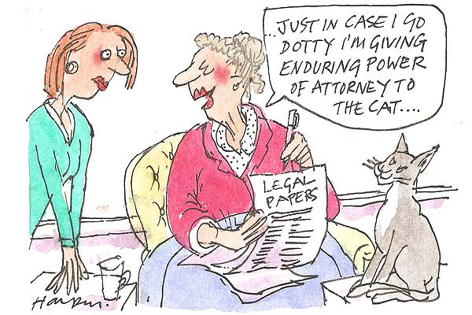
Enduring Power of Attorney
An Enduring Power of Attorney (EPA) is an arrangement whereby a Donor (the person who may lack capacity in the future) gives a general power to an Attorney (the person providing assistance) to act on their behalf.

Slide 48
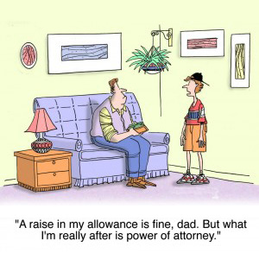
Enduring Power of Attorney
This may be in respect of all or some of the person’s property and affairs, or to do specified things on the person’s behalf

Slide 49
Enduring Power of Attorney
The EPA only comes into effect when registered with the Decision Support Service.
An objection can be made to the Director of Decision Support Service to the registration of an EPA for a number of reasons:
the unsuitability of the attorney
fraud or
undue pressure was used to induce the donor to create the EPA.

Slide 50
Advance Healthcare Directives
Legally recognised statement about your future medical or surgical treatment choices
Comes into effect when you lack capacity
Can appoint a Designated Healthcare Representative

Slide 51
Designated Healthcare Representative
Legally recognised role to:
Advise and interpret the Advance Healthcare Directive
Consent or refuse treatment up to and including life sustaining treatment
Must keep a written record of all decisions made
Can’t delegate their powers to someone else

Slide 52
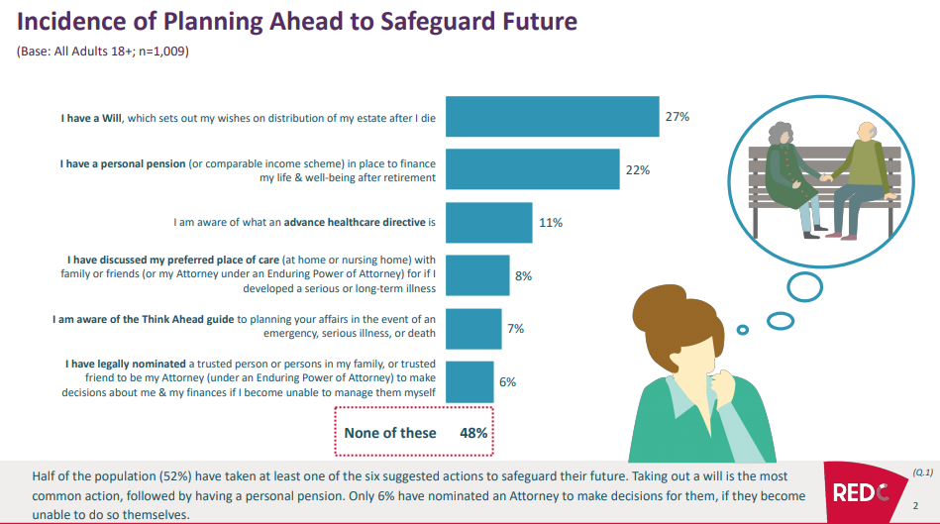

Slide 53
Assisting and Supporting Decision-Making
Appointment by person with Capacity to plan for the future – comes into effect when person lacks capacity
Attorney: Enduring Power of Attorney
Designated Healthcare Representative: Advance Healthcare Directive
Appointment by person when Capacity is in question/shortly in question
Decision-Making Assistant: Decision-Making Assistance Agreement
Co-Decision-Maker: Co-Decision-Making Agreement
Appointment by Court when person lacks capacity – EPA or AHD does not include decision to be made
Decision-Making Representative: Decision-Making Representation Order

Slide 54
Codes of Practice
HSE ADM Steering Group Codes of Practice:
Code for Health and Social Care Professionals
3 x Codes on Advance Healthcare Directives
National Disability Authority
11 Codes of Practice developed in conjunction with Technical Expert Group
Code for Financial Professionals: 12 people from across the financial services sector who bring technical expertise from their relevant practices
Code for Legal Professionals: 5 representatives of solicitors and barristers

Slide 55
Decision Support Service Activity 2019
Staff now being recruited
National Consultation on all of the codes
Public Information Campaign
Establishment of panels and registers

Slide 56
HSE National Assisted Decision-Making and Consent Office
Support for front line services
Guidance and documentation
Education and training
Draft Codes of Practice
Website and information
www.assisteddecisionmaking.ie

Slide 57
The spirit of the Act is to support decision-making…..
….not to determine incapacity!!

Slide 58
HSE Assisted Decision-Making and Consent Office:
Caoimhe Gleeson caoimhe.gleeson@hse.ie
087 650 4793
Jacqueline Grogan jacqueline.grogan@hse.ie
087 190 4787
Elaine McCaughley elaine.mccaughley@hse.ie
087 101 9404
Marie Tighe marie.tighe1@hse.ie
087 627 4815
www.assisteddecisionmaking.ie
adm@hse.ie

